Slide 1
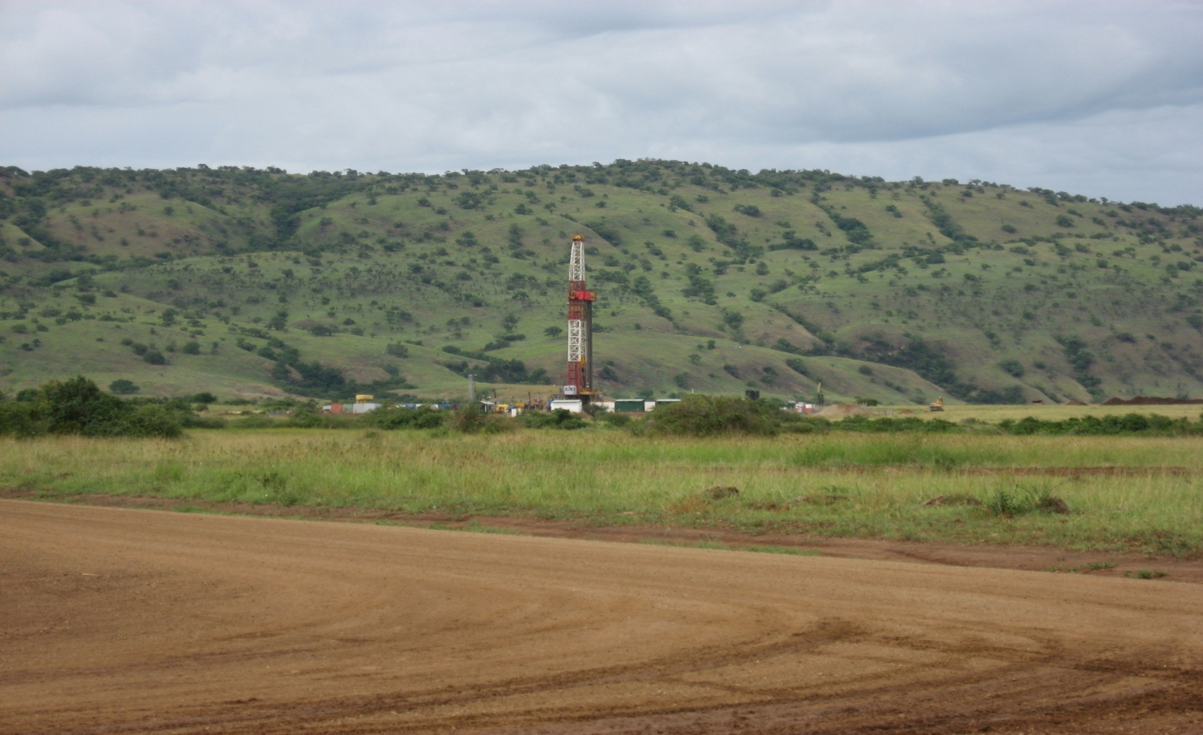

RECENT DEVELOPMENTS AND INVESTMENT OPPORTUNITIES IN UGANDA’S OIL AND GAS SECTOR
Dozith Abeinomugisha
PETROLEUM EXPLORATION AND PRODUCTION DEPARTMENT
MINISTRY OF ENERGY AND MINERAL DEVELOPMENT
Presented at
THE INTERNATIONAL PAVILION: AAPG INTERNATIONAL CONFERENCE AND EXHIBITION
23rd - 26th October, 2011, Milan, Italy

Slide 2
PRESENTATION OUTLINE
1. Introduction
  The Albertine Graben
  Status of licensing in the Albertine Graben
Recent Developments in Uganda’s Oil and Gas Sector
  Data acquisition
  Oil and gas discoveries and Plans for Development and Production
  Implementation of the National Oil and Gas Policy
3. Investment Opportunities in Refinery Development
4. Concluding Remarks

Slide 3
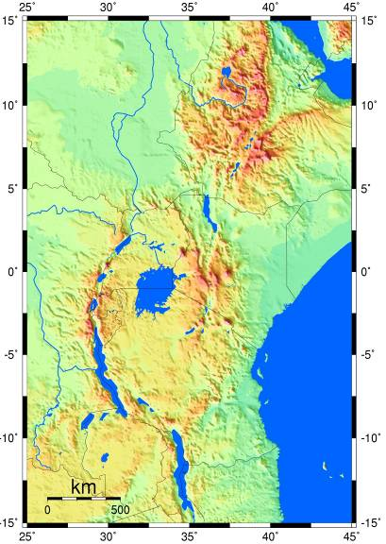
Introduction
THE ALBERTINE GRABEN
The Albertine Graben is the principal area of petroleum prospectivity in Uganda
The Graben forms the northern most part of the Western arm of the East African Rift System
Runs along Uganda – DRC Border
1300 km from the coast
Afar Depression
Abu Graben
Aswa Shear zone
Albertine Graben
Lake Albert
Eastern Arm
Tanzanian
Craton
Lake
Tanganyika
Lake Malawi
Notes:
3

Slide 4
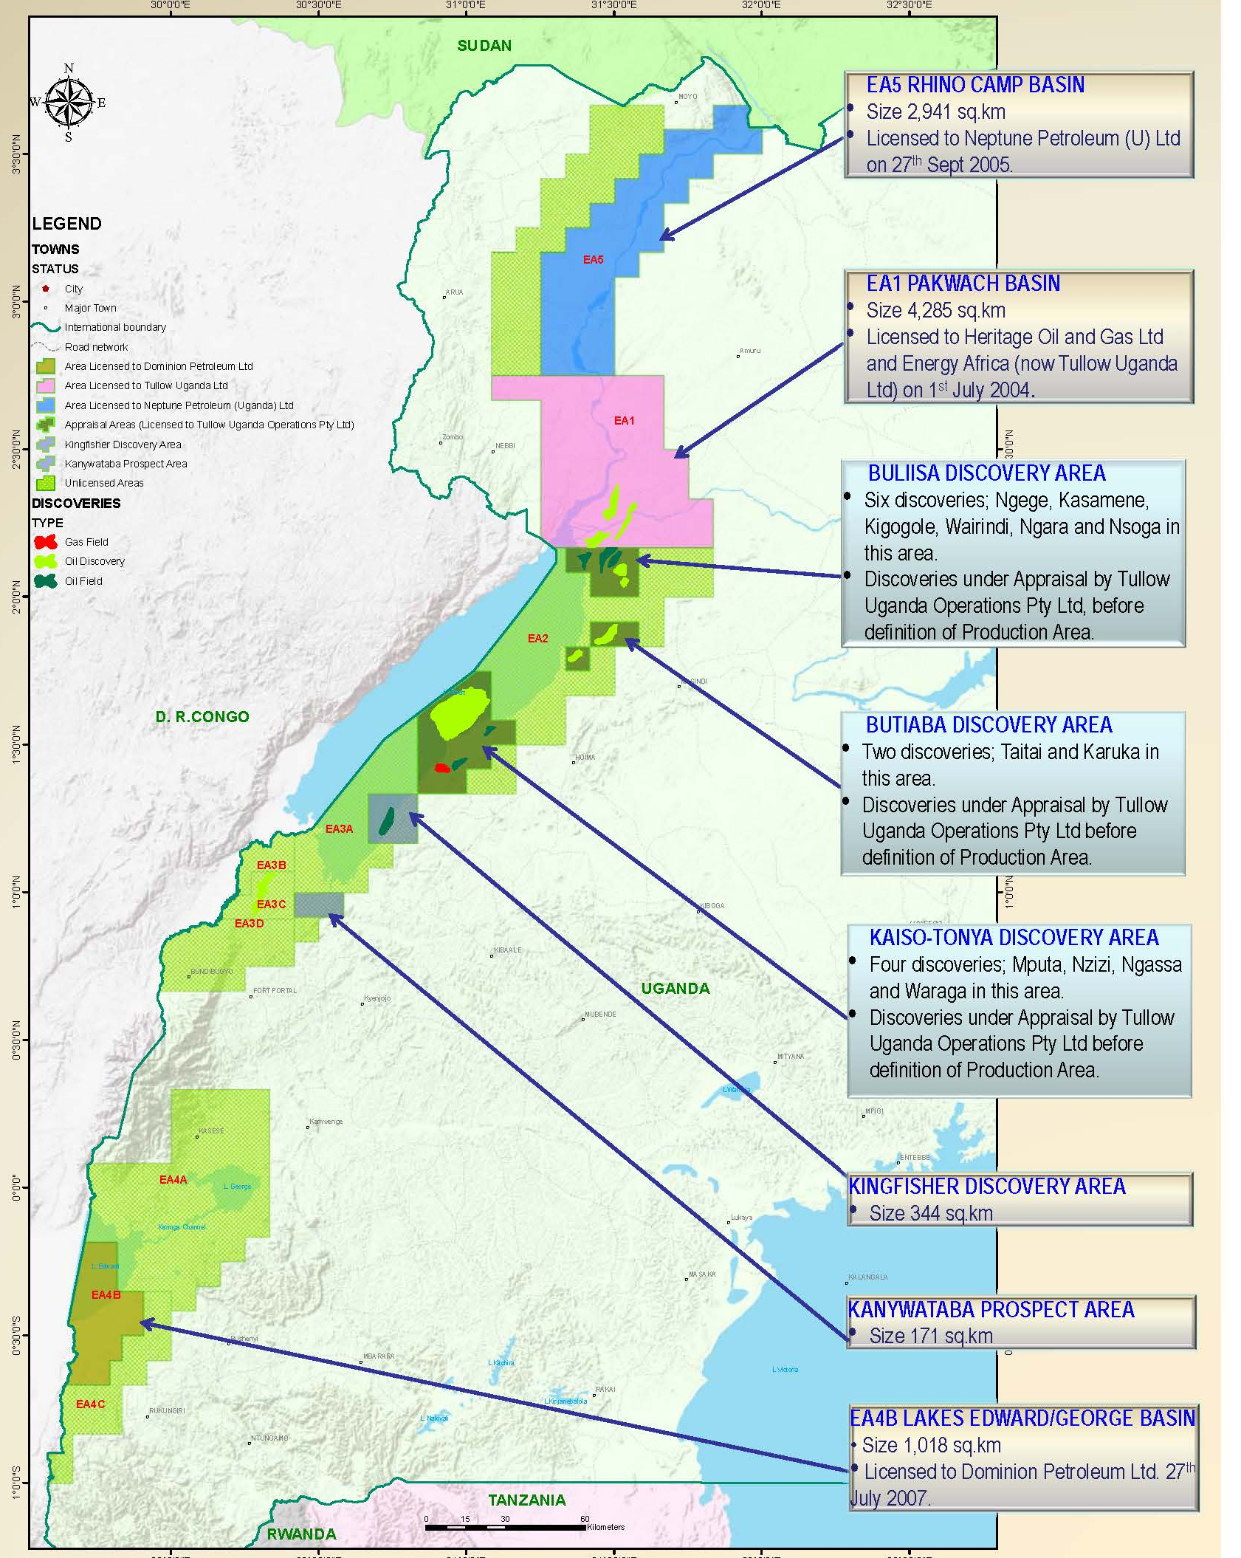



Introduction
Status of Licensing
Albertine Graben is sub divided into 10 Exploration Areas (EAs)
5 Active PSAs
3 PSA Operators
Licensing currently suspended
Tullow is finalizing farm-down to TOTAL and CNOOC
Notes:
4

Slide 5
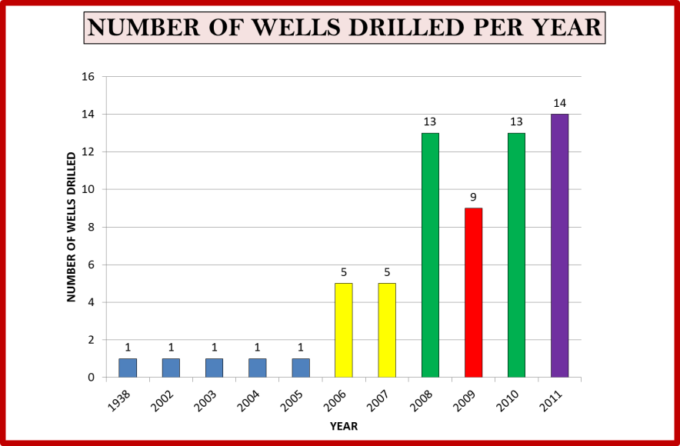
Recent Developments
Data Acquired to date
Data Type | Coverage
Geological Surface Mapping | >10,000 sq km
Aeromag&Aerograv | 16,560 line km
Ground/lake gravity and magnetic | 10,500 line km
2-D Seismic | ~7,000 line Km
3-D Seismic | 1,600km2
Well data | 64 wells

Slide 6
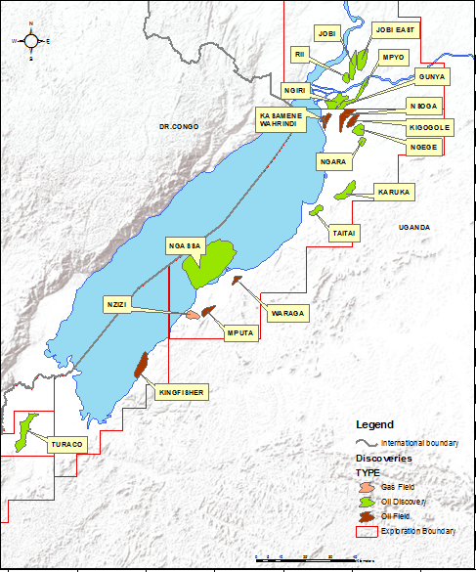
Recent Developments
64 exploration and appraisal wells drilled; 58 successful.
20 oil and/ or gas discoveries made to date.
Over 2.5 billion barrels of oil equiv. in place.
Estimated 1 billion barrels recoverable.
Less than 40% of the Albertine Graben has been evaluated.
Discoveries and Reserves

Slide 7
Recent Developments
Exploration
Exploration continues in Exploration Areas 1, 4B and 5.
Appraisal is being undertaken on the discoveries made in Exploration Areas 1 and 2.
Development
Production License applications have been submitted for Kingfisher discovery in EA 3A and Mputa, Kasamene and Nzizi discoveries in EA 2.
Plans for Production and Refining
Plans for an integrated power project using gas and crude to supply a 50MW power plant
Plans for in-country refinery by 2015
7
Notes:
7

Slide 8
Recent Developments
Implementation of the National Oil and Gas Policy
The NOGP is the key govt. document guiding the development of the oil and gas sector in Uganda.
The Policy was approved in February 2008 after a wide consultative process.
Policy sets objectives and strategies to achieve these objectives.
    Policy Goal:
  “To use the country’s oil and gas resources to contribute to early achievement of poverty eradication and create lasting value to society.”
  Policy available in print and website; www.petroleum.go.ug

Slide 9
Recent Developments
Implementation of the National Oil and Gas Policy
On-going formulation of new petroleum legislation. Current halt in licensing until the new law is put in place
A comprehensive feasibility study on in country refining has been undertaken to ensure value addition.
A petroleum transportation and storage study for the country has commenced. Study to co cover both crude and products.
  Environment Sensitivity Atlas for the Albertine Graben was developed. Strategic Environment Assessment of areas where petroleum has been discovered is on-going.
  Local Content study concluded.
  Skills development for the sector – University /artisan courses in oil and gas
  Communication strategy for the sector has been developed
  Institutional development in on-going

Slide 10
OPPORTUNITIES IN REFINERY DEV’T
Refinery Feasibility Study - Background
GoU contracted Foster Wheeler ( who subcontracted GCA for the market survey and financial analysis) to undertake the study.
To ensure a realistic basis for selection of capacity and configuration, the study included a market survey and a crude production plan and schedule.
Capex and Opex were developed for configuration and capacity options, and a financial analysis to compare refinery economics with crude export pipeline of similar capacity.
The study was concluded in August 2010.

Slide 11
OPPORTUNITIES IN REFINERY DEV’T
Refinery Feasibility Study - Objectives
Establish optimum capacity and required infrastructure
Configurations with cost estimates
Review viability of alternative commercialisation of the crude via export pipeline
Determine suitable location
Analyse socio-economic impact and impact on environment
Recommend ownership and financing options

Slide 12
OPPORTUNITIES IN REFINERY DEV’T
Refinery Feasibility Study – Results and Recommendations
Mild Hydrocracker/Fluidised Catalytic Cracker/Coker (MHCK/FCC/Coke) provides the best mass balances with forecast market demand
60,000 BOPD considered a reliable and robust base case (phased from 20kbd). Potential to expand to 120kbd and 160kbd with further discoveries.
A 20,000 BOPD has been evaluated and would need Capex of US$382m and the post-tax ROR are 29%
Project economics assessed and found to be robust. The key driver being import parity-based realised product prices
The study concluded that the pipeline option is not the preferred one due to the need to heat the pipeline along the entire length (>1,300km).

Slide 13
OPPORTUNITIES IN REFINERY DEV’T
Refinery Feasibility Study – Actions being taken
A location close to the oil fields was chosen
Private or Publice-Private Partnership recommended as a financing model for the refinery project.
Procurement ongoing for a financial / transactions advisor/ to advise the Govt. on the refinery development programme.
Govt. has identified and demarcated land for the location of the oil refinery, and is in the process of acquiring the land.
Promotion of the refinery project being undertaken.

Slide 14
Concluding remarks
Efforts on petroleum exploration in Uganda has been on for the last 50 years but the actual progress has been registered in the last decade.
Exploration effort have led to the discovery of over 2.5 billion barrels of oil equivalent in place in the country and this is expected to increase.
The National Oil and Gas Policy is the key policy document guiding the developments in the sector, and implementation of the policy objectives has commenced.
The refinery feasibility study has defined very attractive investment opportunities on a sound technical and economic basis

Slide 15
Thank You
For further information, please visit Uganda’s Booth at the International Pavilion,
or contact;
THE COMMISSIONER,
PETROLEUM EXPLORATION AND PRODUCTION DEPARTMENT
Email: pepdebb@petroleum.go.ug
Web: www.petroleum.go.ug
15
Notes:
15
15

