Slide 1
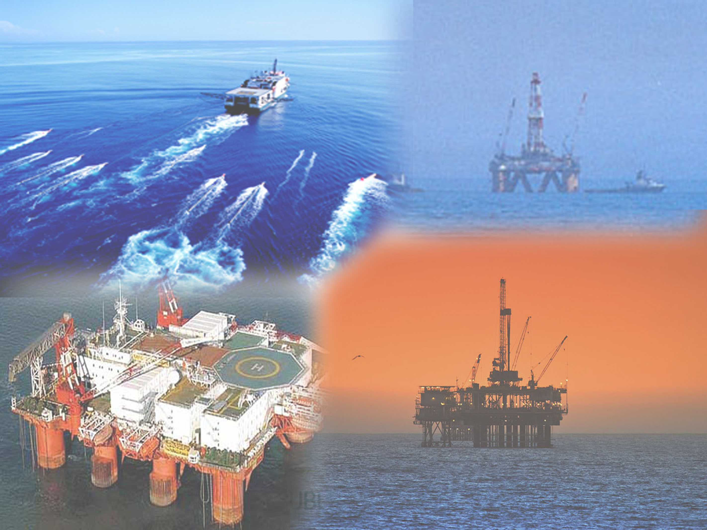
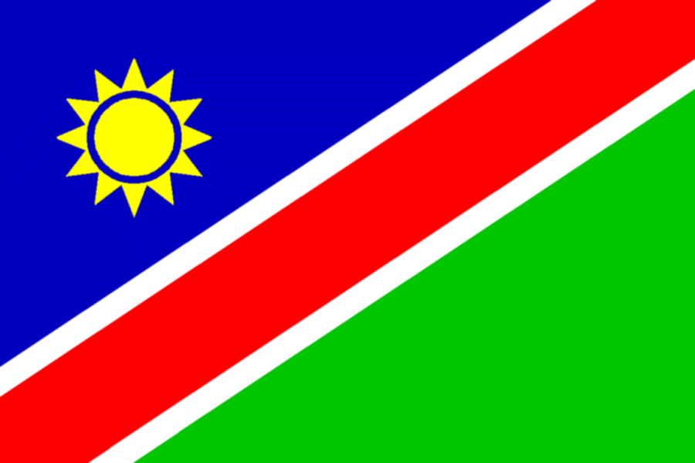

AAPG International Conference & Exhibition
Hydrocarbon Exploration in Namibia, current status and future challenges
Speaker:
Manfriedt Muundjua
Geoscientits (NAMCOR)

Slide 2
Presentation outline
INTRODUCTION
PRODUCTION PROJECT
Kudu gas field
EXPLORATION PROJECTS
Onshore Exploration
Conventional Oil and Gas
Non-Conventional Gas
Offshore Exploration
Current exploration activity in offshore Namibia basins and future perspective
Conclusions

Slide 3
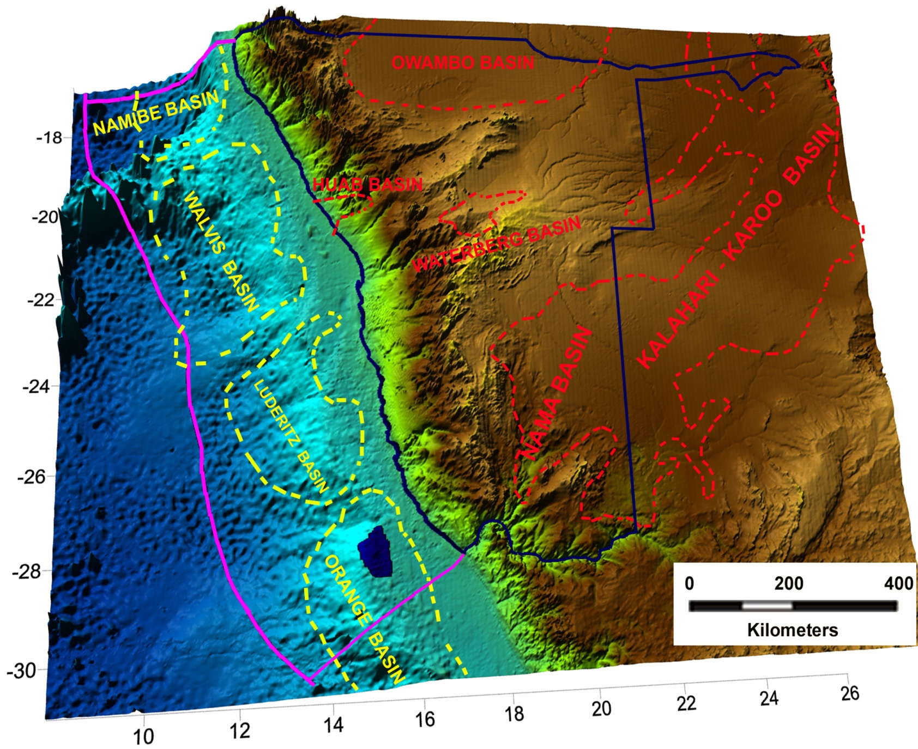
Introduction
Namibia is a South-west African coastal democratic state, which has a vast area for hydrocarbon exploration, both offshore and onshore of about 1,390,166 km2, of which 564,748 km2 is marine area

Slide 4
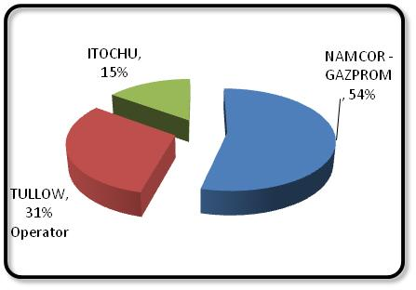
PRODUCTION PROJECT
Kudu gas field
The Kudu gas field which is located 130 km off the southwestern coast of Namibia was discovered in 1974 by Chevron and partners.
The gas from the Kudu field has been reserved to supply a power plant with a capacity of 800MW to be built in Namibia.

Slide 5
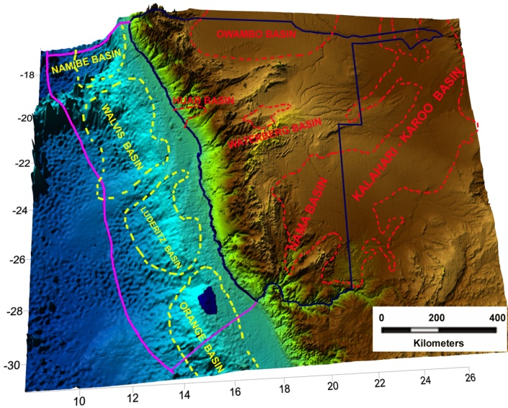
EXPLORATION PROJECTS
Onshore Exploration: Conventional Oil and Gas
Owambo (Etosha) basin
The Owambo (Etosha) basin is Precambrian in age and its geological record comprises the Rodina supercontinent break-up, formation and assemblage of Gondwana and finally the formation of the African continent.
This geotectonic regimes, were responsible for the favourable occurrence of the essential elements and processes of the petroleum system. The existence of bituminous materials from outcrops and reported oil shows in well 5-1A, suggests the presence of an active petroleum system.

Slide 6
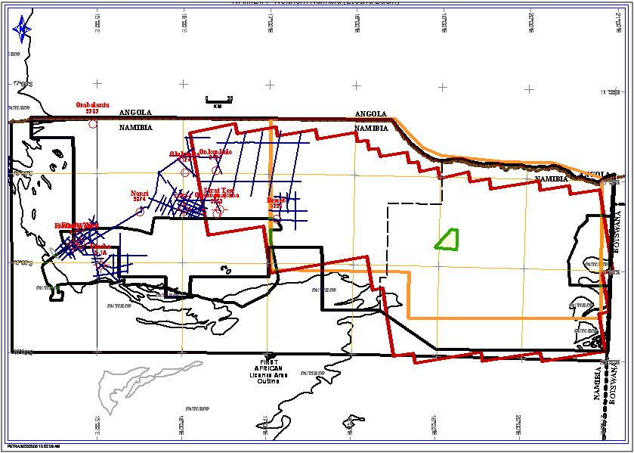
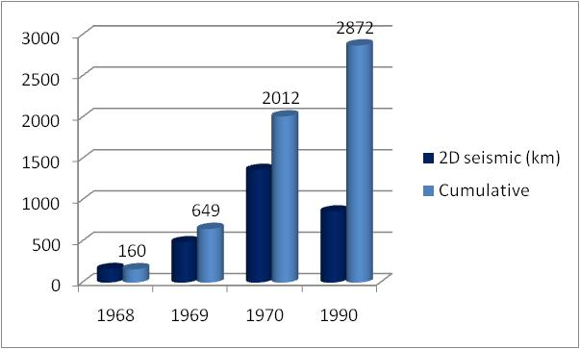
Owambo (Etosha) basin (cont…)
Only 2,872 km of 2D seismic data acquired to date, 2,010 km acquired pre-1971 and the remaining 860 km was acquired in 1990.
Aerogravity and aeromagnetic data also exist.

Slide 7
Owambo (Etosha) basin (cont…)
Idealized cross-section through the wells: 5-1A, 2-1, 1-1, DDH 9074, DDH 9563 and ST-1, showing the different exploratory plays in Owambo basin. A: Structural trap (pop-up) associated with trans-pression in the border of the basin; B: Structural trap associated with localized trans-pression; C: Drape over basement highs; D: Stratigraphic trap associated with carbonate build-ups (modified from Miller 1997).

Slide 8
EXPLORATION PROJECTS
Onshore Exploration: Conventional Oil and Gas
Nama Basin
Similarly to Owambo, the Nama basin also has a risk associated with possible over maturity of potential source rocks. However, the presence of live oil in a fault in Kuibis Formation sandstone and also the finding of bitumous material in Fish River outcrops demonstrate the presence of an active petroleum system in the basin.
To date 4 wells (Berseba-1, Tses-1, Nutupsdrift-2 and Vreda) have been drilled in the Nama basin.
The Berseba-1 well had a gas blow out.

Slide 9
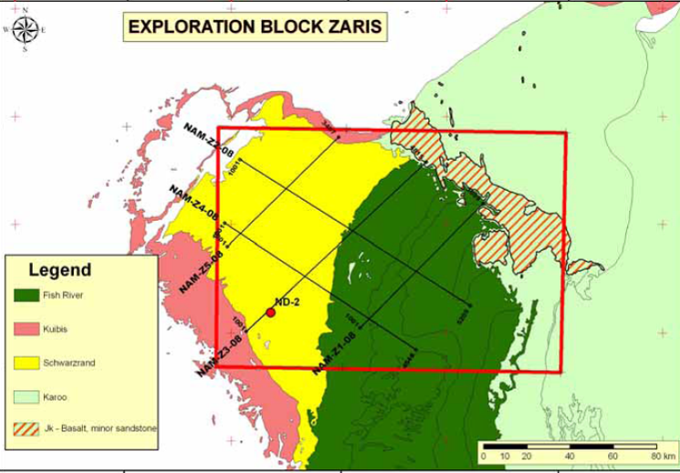
Nama basin (cont…)
The seismic coverage is very poor, only the 500 km of 2D seismic of good quality, is available for exploration, consisting of 5 seismic profiles with separation distances of about 30 to 35 km
INA (2008)

Slide 10
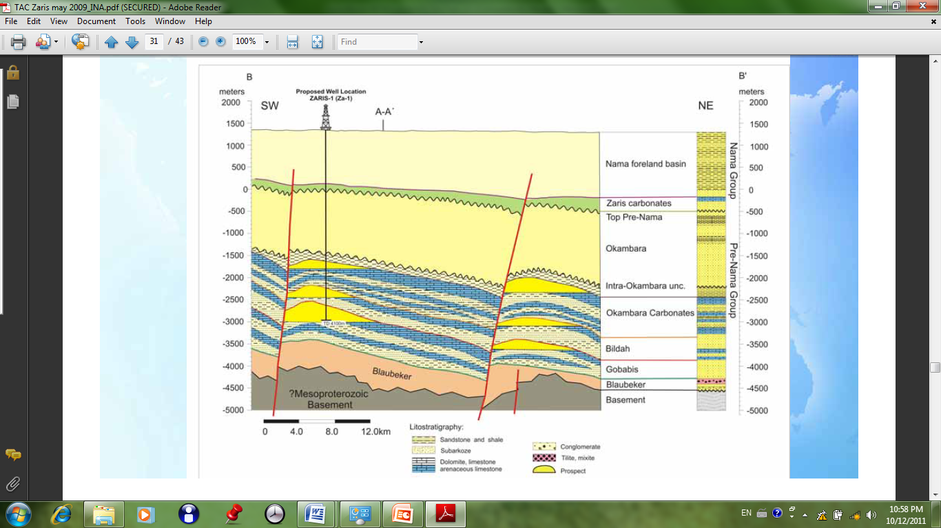
Nama basin (cont…)
The interpretation of the seismic data resulted in the identification of 2 prospects and 1 lead for exploration. For the two prospects a total of 1.8 billion barrels of original oil in place (OOIP) and of about 403 million barrels of mean prospective resources were estimated.
The trap associated with the Zaris prospect is a structural three way closure against a normal fault.
Note that there are three different reservoir levels within the same structure pattern (INA, 2008)

Slide 11
EXPLORATION PROJECTS
Onshore Exploration: Non Conventional Oil and Gas
Coal Bed Methane
In southern Africa there exist several basins in which coal beds were deposited from the Carboniferous up to Jurassic, in a lacustrine environment. In Namibia studies in this regard have shown the occurrence of coal beds in Owambo (central part), Nama (eastern part), Haub and Waterberg basins.
The first project carried out for coal bed methane was by Aranos Gas in the onshore Block 2419 and 2519. The project consisted of a drilling campaign to evaluate the methane gas content in the coal. After drilling the 6 proposed wells the operator decided to terminate the project due to the very low concentration of methane gas desorbed from the cores of coal.

Slide 12
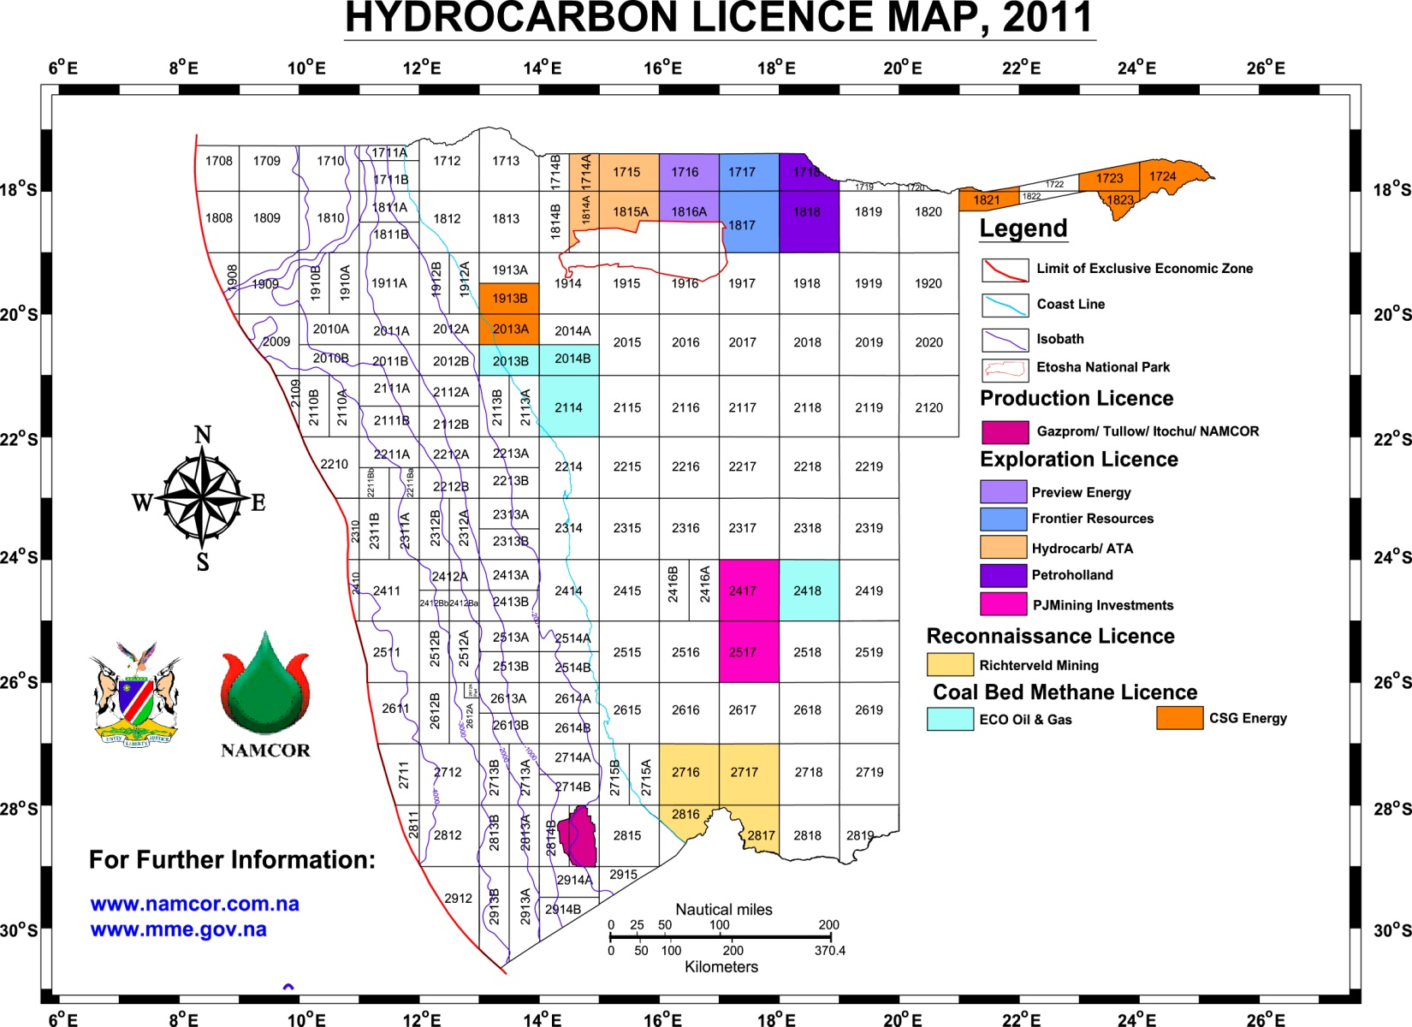
EXPLORATION PROJECTS
Onshore Exploration
Current status and future perspective for exploration in onshore area

Slide 13
EXPLORATION PROJECTS
Offshore Exploration
Seismic exploration carried out to date and plan until 2016
Hydrocarbon exploration offshore Namibia has passed through different phases:Phase 1 from 1968 to 1974; Phase 2 from 1974 to 1986; Phase 3 from 1986 to 1990; Phase 4 from 1990 to 1999, and; Phase 5 from 1999 to date.

Slide 14
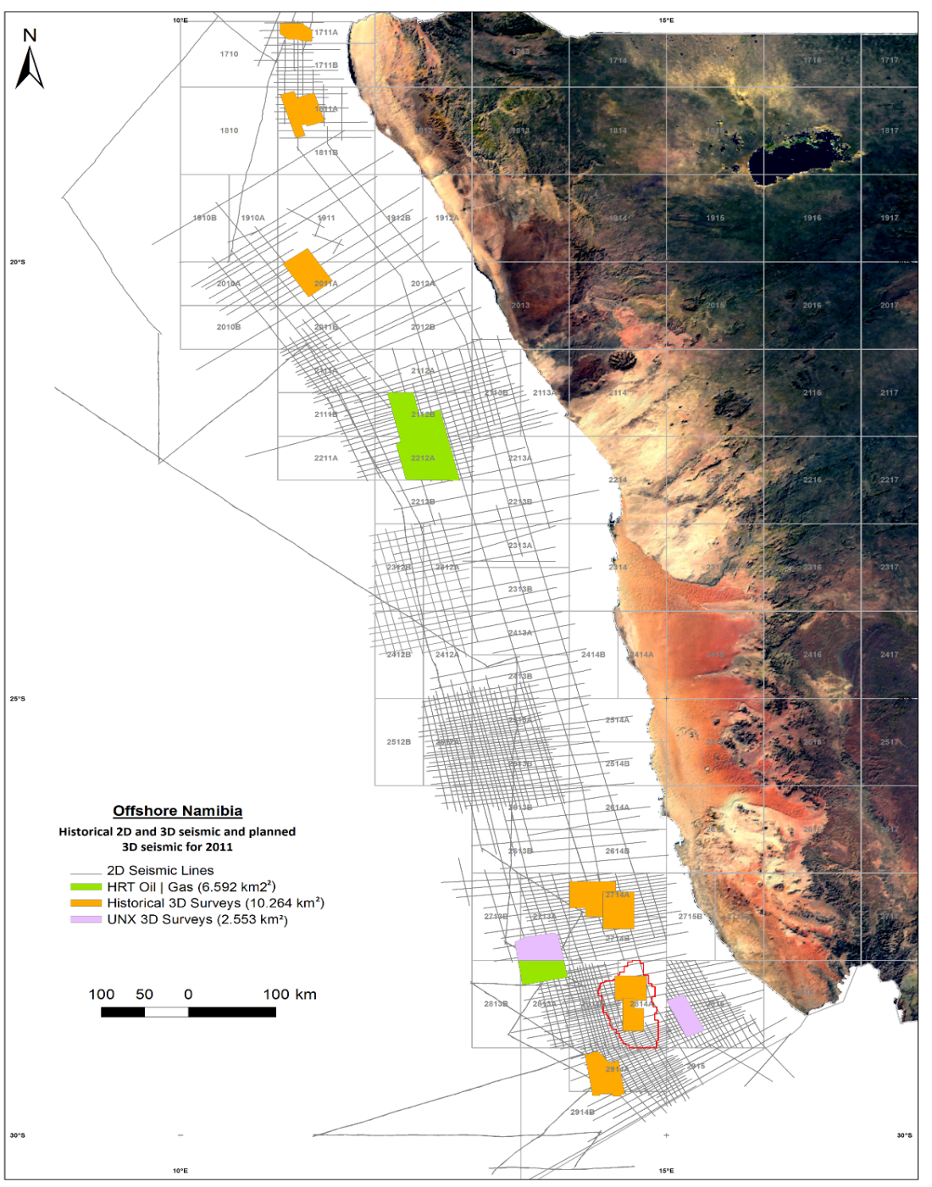
Seismic exploration carried out to date and plan until 2016 (Cont…)
Although the 2D coverage offshore Namibia is quite impressive (which constitute a data base of more than 85,000 line km).
There are some areas were 2D data is desperately needed.
We have also noted a marked increase in the amount of 3D acquired in recent years, with more than 9,000 km² to be acquired by the end of 2011, bringing the total 3D data base to just under 20,000 km².

Slide 15
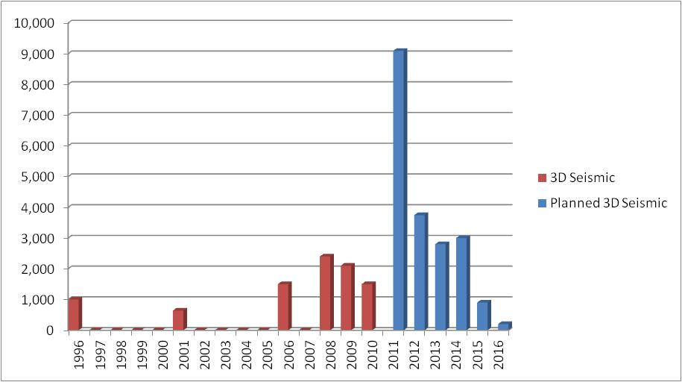
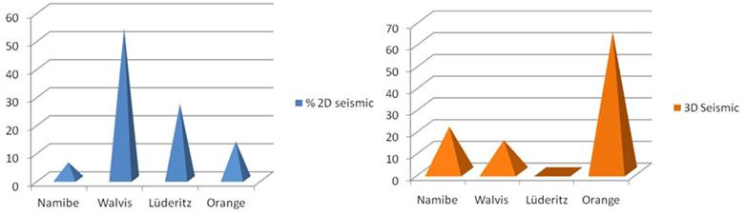
Seismic exploration carried out to date and plan until 2016 (Cont…)

Slide 16
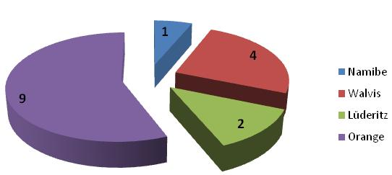
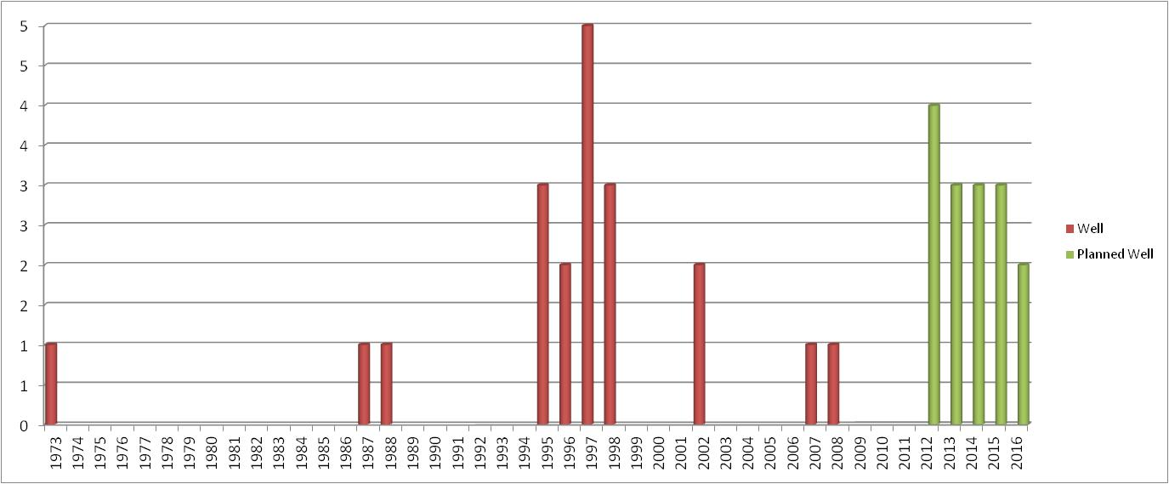
EXPLORATION PROJECTS
Offshore Exploration: Exploration drilling
To date 16 exploration and appraisal wells have been drilled offshore Namibia. However of these 16 wells, 8 are in the Kudu gas field.

Slide 17
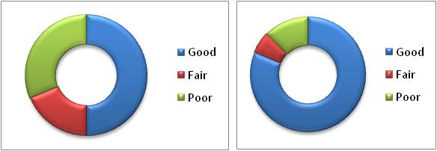
Offshore Exploration: Well failure analysis
A detailed analysis of the current 16 exploration wells was conducted, based on source rock potential, reservoir, trap and seal.
Source potential- migration pathways
Reservoir
50% of the wells had good source rock potential and migration pathways, while 30% have poor source rock potential and migration pathways.
The reservoir analysis shows that most of the wells had good reservoir quality in multiple stratigraphic levels, from the Synrift (Barremian) section to the Tertiary section.
In offshore Namibia, reservoir is not a risk factor at all.
Detailed mapping of faults, fracture areas etc, could reduce the risk by analyzing which of the prospects are connected to the kitchen areas.

Slide 18
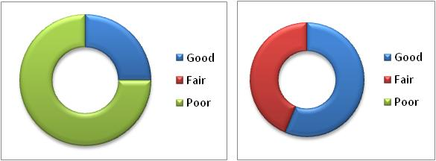
Offshore Exploration: Well failure analysis (Cont…)
Trap
Seal
Trap has been the main cause for the failure of most (75%) of the wells.
The failure can be attributed to the historical mapping of traps based on 2D seismic, which is not adequate to image subtle structures, stratigraphic traps, closure of traps and trapping mechanism.
We are hoping to mitigate this risk element by insisting that future wells are drilled based on 3D seismic.
All the wells the quality of the seal was either good or fair.
Like reservoir, seal is everywhere in offshore Namibia. It thus not a risk factor at all.

Slide 19
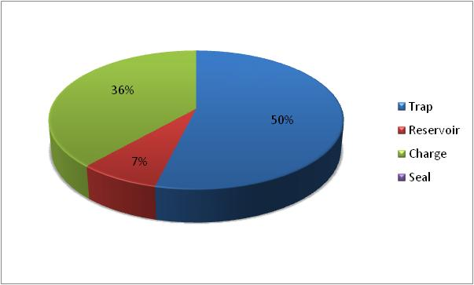
Offshore Exploration: Well failure analysis
Summary

Slide 20
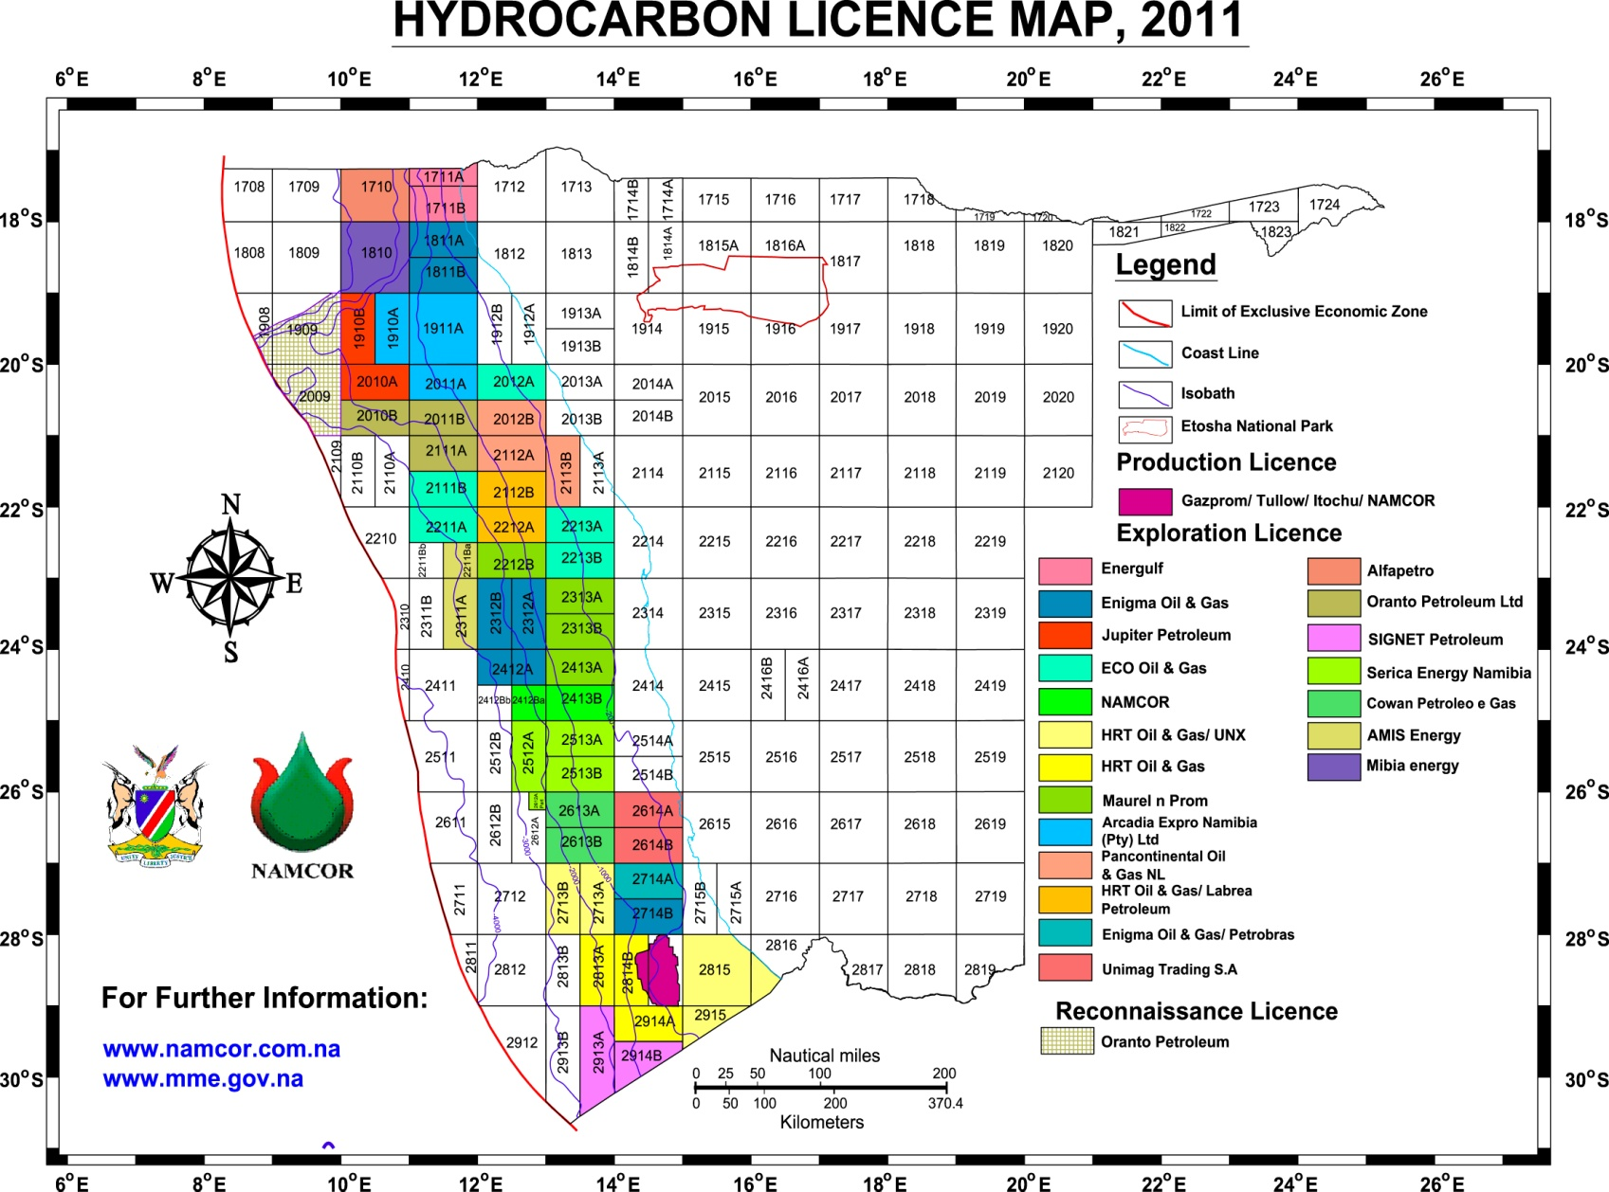
EXPLORATION PROJECTS
Offshore Exploration
Current exploration activity in offshore Namibia basins and future perspective

Slide 21
Leading exploration companies in offshore Namibia in the last 5 years
Tullow Oil
Sintezneftegaz
Enigma/Chariot
Drilled Kudu-8
Production license (Kudu)
Drilled Kunene-1 well
Demonstrated 2 active petroleum systems similar to the present in offshore Brazil.
4500 km² 3D Seismic
1500 km 2D Seismic
US$ 80 million to date
Mapped 17 prospects and leads
Ready for drilling northern and southern blocks
Gazprom
Itochu
Namcor
Arcadia
HRT Oil & Gas
1500 km² 3D seismic
Processing and interpreting seismic information.
Good prospects have been revealed , possibility to drill in 2012
Re-processing & interpreting 1130km existing of 2D seismic, high resolution geochemical analysis, satellite seepage detection, advance geochemical evaluation
Universal Power Corp
Raised $ 1.54 billion in IPO Re-processing &
Acquisition of more 9 000 km2 of 3D and planning to drill more than two wells from 2012.

Slide 22
Estimates of resources and reserves and future perspective of exploration
Recent estimates suggest offshore Namibia contains about 166 billion barrels of original oil in place (OOIP).
The mean prospective resources are of about 42.6 billion barrels of oil and 128.8 Tcf (3.6 T cubic meters) of gas prospective resources.
This result could locate offshore Namibia as one of the larger oil and gas resources container in West Africa coast.

Slide 23
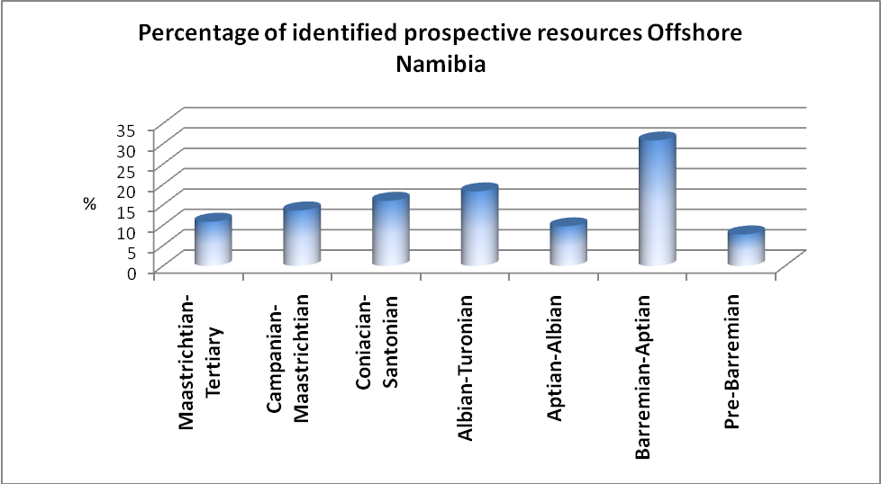
Estimates of resources and reserves and future perspective of exploration
Results of resource estimation and play analysis show the relevant importance of the Barremian-Aptian play in offshore Namibia; it estimated to contain 30 % of the total estimated resources. Other relevant plays intervals are the Albian-Turonian and Conocian- Santonian.
This permits to direct the exploration effort to the more prolific plays in the area, so that the exploratory perspective should be focused on those plays.

Slide 24
Conclusions
Heighten interest in the Namibian basins, particularly in the offshore areas.
According to analyses of current exploration wells, the main reasons for well failure were traps, source and migration pathways.
The risk associated with reservoir and seal rocks is minimal or zero. There is reservoir and seal rocks everywhere and in different age intervals. From the Barremian to present day.
All wells were drilled on the basis of 2D seismic, which is not highly attractive if most of the plays are stratigraphic in nature.

Slide 25
Conclusions
Commitment to acquire a large quantity of data including unprecedented campaign for 3D seismic will enable the drilling of mapped prospects in the shortest possible time.
Another notable target of recent years has been the exploration for non-conventional hydrocarbons, particularly coal bed methane.
The main plays in offshore Namibia are the Aptian-Barremian and Albian-Turonian.

Slide 26
Conclusions
8. There has been a welcoming interest for exploration in the Owambo Basin in which structural and stratigraphic plays have been identified.
9. In the Nama Basin is clearly more under explored compared with the Owambo Basin, but the presence of reported oil and gas seeps has favoured the interest of some company to carry out exploration.

Slide 27
Thank you very much

