Slide 1
Competitive Bidding
2011

Slide 2

Outline of Talk
Introduction
  Framework for Presentation
Shallow Water Bid Round - Results
Deep Water Bid Round – Results
Analysis of Results
MEEA’s view on the Deep Water Blocks
Block Nomination
CBO 2011

Slide 3

Gas utilisation began 50 yrs ago
Current Gas Production 4.1bcf/d
Population - 1.3M
Labor Force - 0.5M
Literacy Rate - 88%
LOCATION
Northeast of Venezuela
Southernmost of Caribbean
Total Area – 1,864sq. miles
Commercial oil production began 102yrs ago
Current Production-100,000 bopd

Slide 4

Government’s Focus
Sustainable development of the energy industry
Provision of a competitive framework for investment
Provision of gas for expansion of downstream industries
Rebalance oil and gas production
Enabling greater participation of nationals and national enterprises in the energy sector
Notes:
provision of incentives for investment

Slide 5
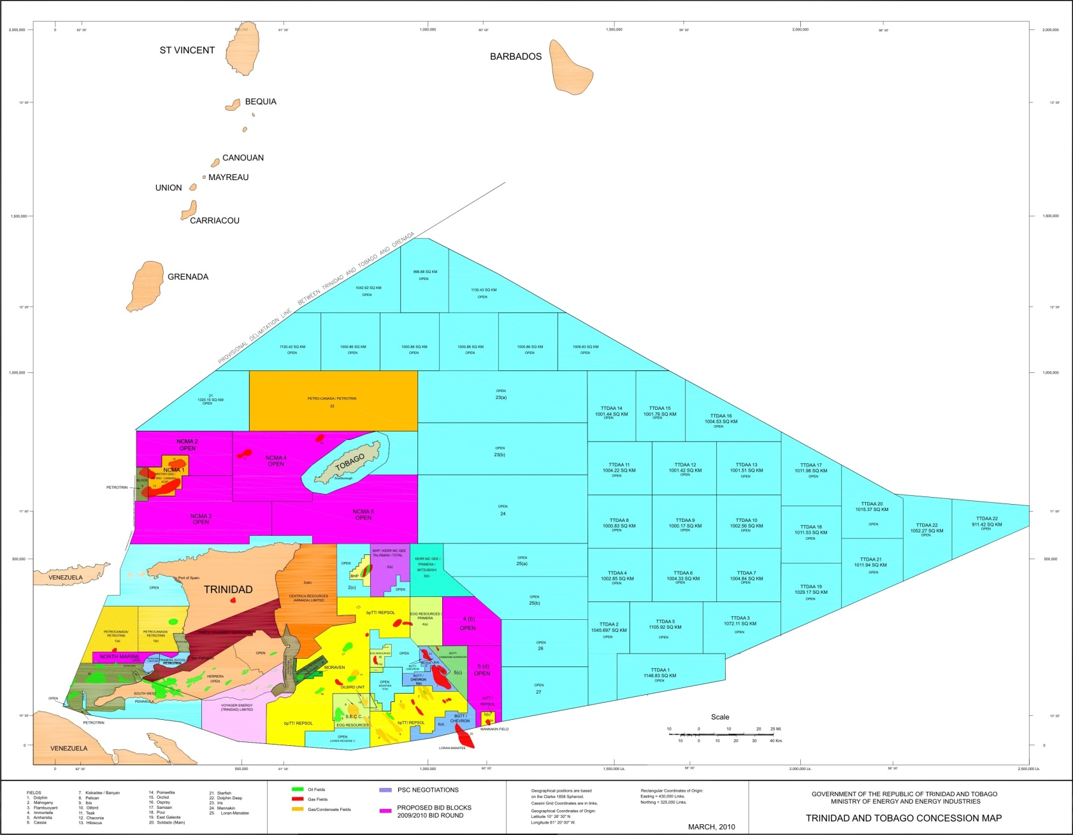
2009 Shallow and Average Water
Acreage Offered
Blocks Offered
NCMA 2
NCMA 4
NCMA 3
NCMA 5
4(b)
North Marine
5(d)

Slide 6
Results of Bid Round/1
North Marine Block -280 sq km
  The bid was not accepted
Block NCMA 2 - 1,019 sq km.
  Block awarded to a Niko Resources/RWE AG Consortium
Block NCMA 3 - 1,019 sq km.
  Block awarded to Niko Resources

Slide 7
Results of Bid Round/2
Block NCMA 4 - 1779 sq km.
  Block awarded to Centrica Resources
NCMA 5 - 2,311 sq km
  No bid received
Block 4(b) - 750 sq km
  Block awarded to Niko Resources
Block 5(d) - 684 sq km
  Not awarded

Slide 8
Status
Contract Negotiation is complete
Contracts should be executed before the end of April, 2011

Slide 9
Competitive Bid Round No. 2
(Deep Water)
2010

Slide 10
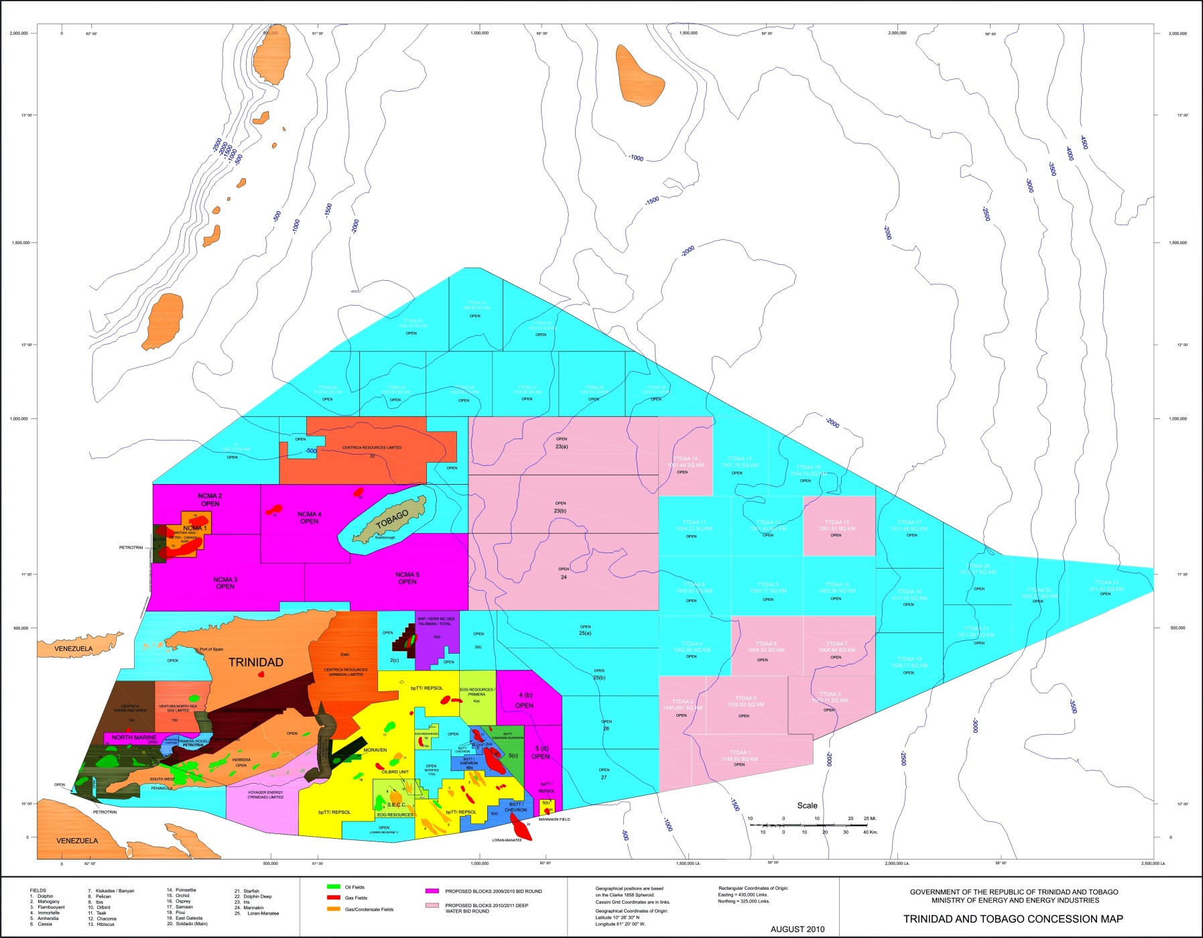
Trinidad and Tobago Upstream Activity Map showing Deep water Blocks Offered
Block 23(a)
Block 23(b)
TTDAA 14

Slide 11
Deep Water Bid Round
39 blocks in water depths 1,000 – 3,500 metres offered for nomination
Eleven blocks were offered for bids
5 bids were received
  Block 23(a) – 3bids
    BPEOC
    BHPB/TOTAL/Repsol
    Niko Resources
  Block 23(b) – BHPB/Repsol
  Block TTDAA 14 – BPEOC
Bids are currently being evaluated
Announcements of the preferred bidder by April, 29, 2011

Slide 12
Analysis of Results
Results still being analysed
Technical Risk seems to be an issue
  Likely Product – ?Gas/Oil/Wet Gas
  Companies want data which actually image the source rock
No issues with the revised Fiscal Regime
  Offered incentives for deep water exploration and production
Will again address the technical risk

Slide 13
Analysis
Phase 1 DGA report recommended reprocessing of the lines used in evaluation of the acreage
Velocities utilised in processing too slow
Observations about source rock and its maturation is an issue
Especially so in the southern TTDAA blocks
CaribeSpan lines will be reprocessed by ION/GXT

Slide 14
Analysis
Most companies would prefer oil
The MEEA based on the studies done is of the view that there is oil to be found in the southern part of the basin
A scan of the global environment with respect to gas is interesting
  While in sympathy with the misfortune of others, it seems that gas will be once again in ascent in markets outside of North America
However, the following slides reemphasize our view on the product being oil in certain areas of the deep water

Slide 15
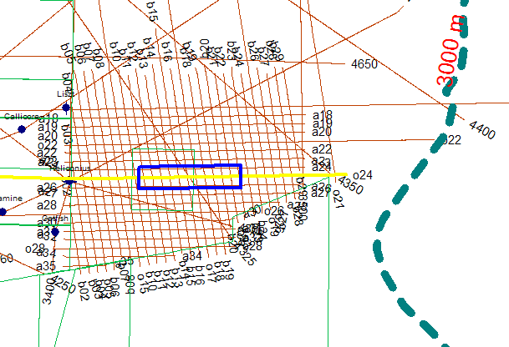
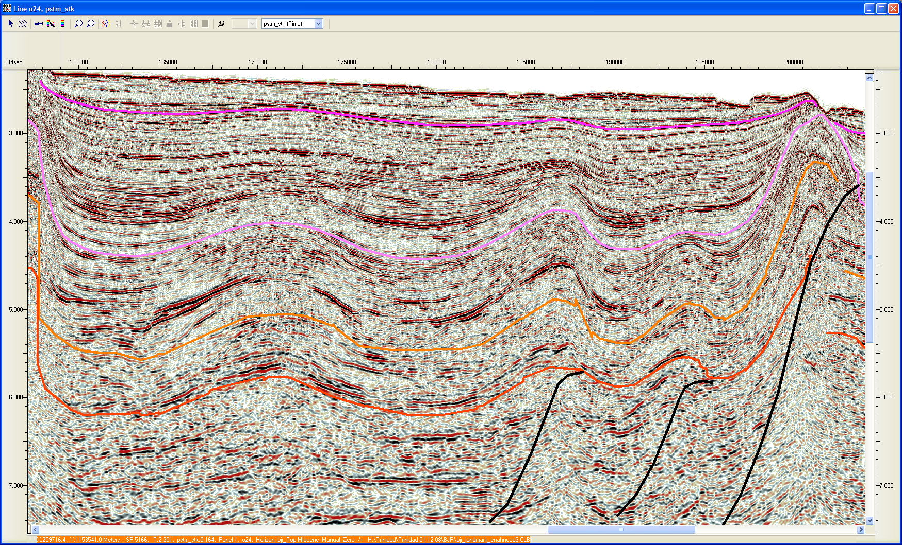
Sheet Fans Provide Multiple Reservoir/Seal Targets
Trinidad fans show excellent lateral extents
Block TDAA5
Open
5 km
Pleistocene
Pliocene
Miocene
Mid-Miocene
Sheet fans deposited at early lowstand time

Slide 16
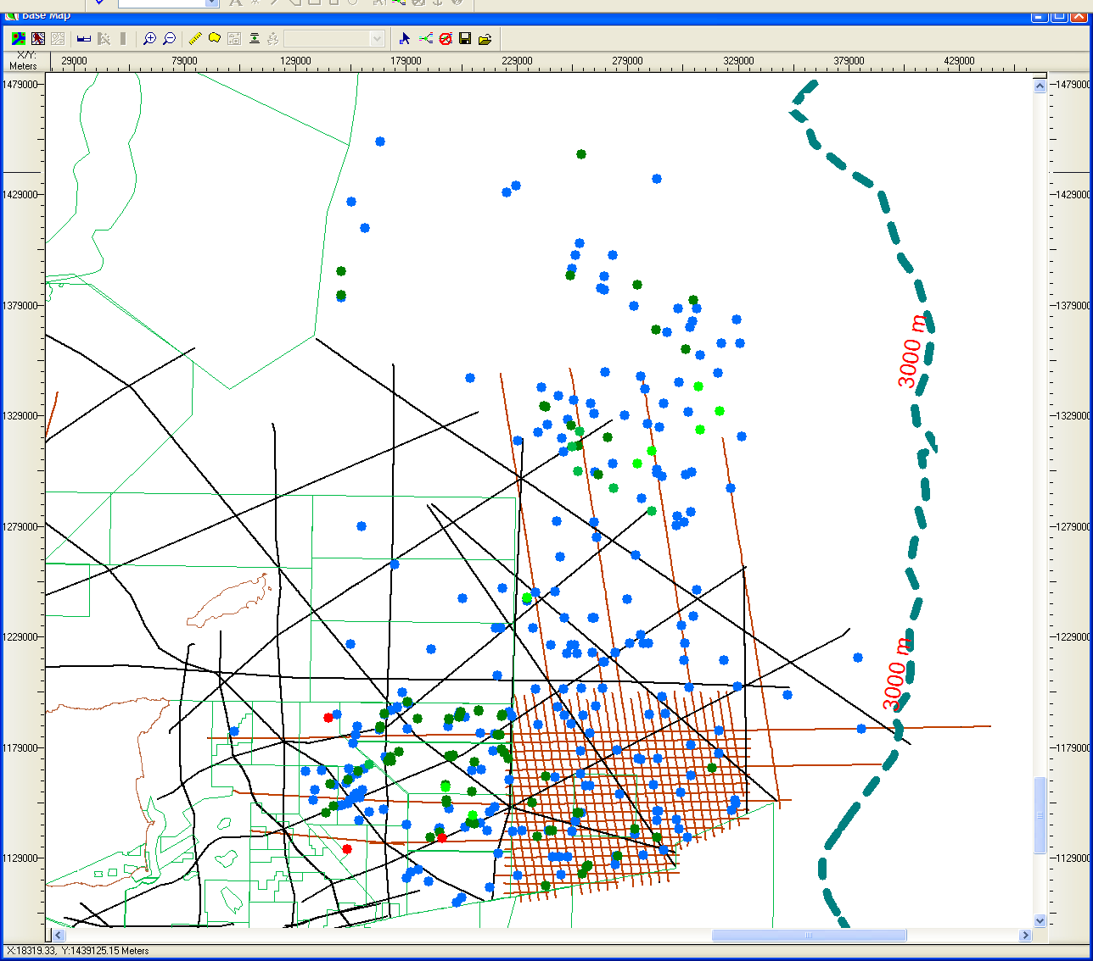
Trinidad Piston Cores Show Live Oil and an Active Hydrocarbon System
Total Piston Cores 449
Cores with Live Oil Shows 8
Cores with C15+ Heavies
GT 10000 units 7
Cores with C15+ Heavies
GT 1000-LT 10000 units 84
Cores with C15+ Heavies
LT 1000 units 260
The summary slide for the piston core surveys uses a straightforward scheme of total heavies of C₁₅₊ and divides the wells into groups denoted on the map by a color coded well symbols. The distribution shows an active hydrocarbon system operating throughout the area. The recent wet gas discovery in Victory 1 is noted.
50 km
Gas Shows / Discoveries 3
Pepper Sauce 1 Gas Show
Dynamine 1 30’ Gas Sand
Victory 1 Discovery
Tobago
Trinidad

Slide 17
Accretionary Prism Oil
Source
  Naparima Hill and Gautier fluids
  Need to be in upper to middle Miocene to avoid biodegradation
Seal
  Excellent seals exist in the Pliocene and Pleistocene
    No reason not to expect these seals further offshore
  Traps do not appear to be overpressured to fracture seals
Reservoir
  Proven reservoirs in Sandy Lane to Oligocene
Trap
  Look for early forming traps
    Recent movement on traps is risky but seals are ductile (high Poisson’s ratio)‏

Slide 18
Accretionary Prism Oil
Timing
  Timing is good for oil generation but not for gas
  Movement of the Eocene/Oligocene mobile shale controls both seal and heating rate of source rocks
    Constraining this movement will have a strong impact on both seal and timing
  Petroleum system will be leaking
    All of Columbus basin is leaking
      Filling faster than it is leaking
    Late movement of faults affect seals
      Mitigated by ductile shales in Pliocene and Pleistocene
  Cool basin means any prospect can be tested between biodegradation limits and the source rock

Slide 19
Call for Nominations
The MEEA is again calling for nominations of deep water blocks
There are 36 blocks from which nominations can be made
Companies will be required to submit a letter to the Minister identifying the block(s) nominated
Each company may nominate up to five blocks
All nominations will be treated as confidential
Nomination is free
Final determination of blocks to be offered in another bid round will be made by MEEA
Nomination comes with no obligations on the part of either party

Slide 20
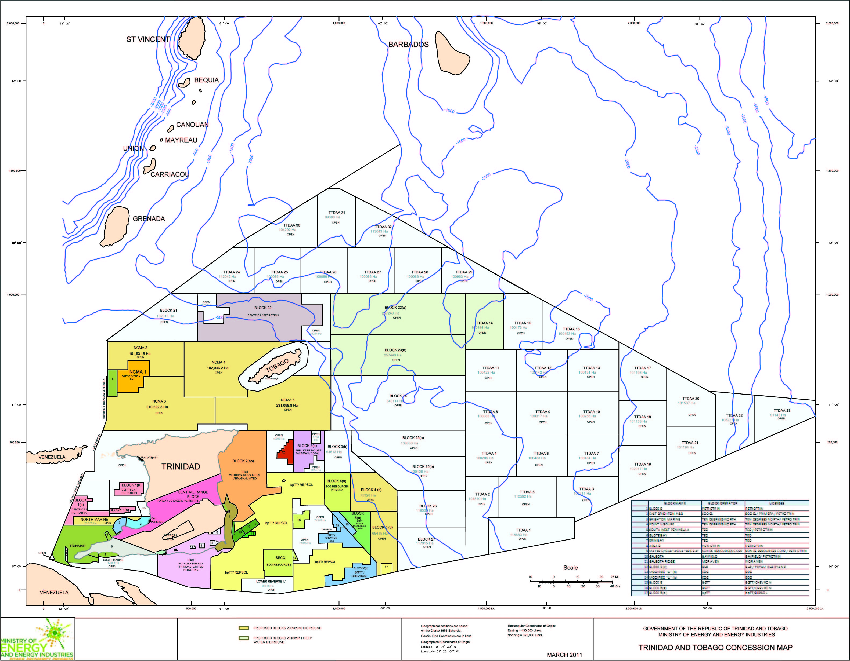
Trinidad and Tobago
Upstream Activity Map
Nominations may be made from the deep water blocks which are not coloured

Slide 21
Deep Water Exploration
Commercial Terms (re-emphasised)
  Conventional styled (non taxable) PSCs, with the following features:
    GORTT’s Share of Profit Petroleum are inlieu of taxes with exception of the payment of Withholding Taxes and Stamp Duty
    Ring-fenced – There will be no consolidation
    Profit Shares are biddable, matrices will be open with no constraints to bidding (Production is incremental)
    Financial Obligations are fixed in the Contract
    Cost Recovery Limit fixed at 60%
    No carried Participation
    Fair Market Value as defined in Petroleum Taxes Act is utilised for the pricing of gas

Slide 22
Deep Water: Profit Share Matrices
Crude Oil
Price MBOPD | A | B | C | D
 | < $50.00 | $50.00 -$75.00 | $75.00 -$100.00 | > $100.00
 | %
< 75 | X | X | X | X
75 - 100 | X | X | X | X
100 - 150 | X | X | X | X
150 – 200 | X | X | X | X
> 200 | X | X | X | X
Natural Gas
Price MMCFD | A | B | C | D
 | < $4.00 | $4.00 - $6.50 | $6.50 -$9.00 | > $9.00
 | %
< 200 | X | X | X | X
200 - 350 | X | X | X | X
350 - 500 | X | X | X | X
500 - 750 | X | X | X | X
750 – 1,000 | X | X | X | X
> 1,000 | X | X | X | X
X represents the Governments Share of Profit Petroleum which is biddable
No carried participation
  Windfall Feature:
  BR + 70%*[(P – US$100.00) / P]*(1-BR)
  Where:
  BR is the base rate at Column D
  P is the market price
  Windfall Feature:
  BR + 70%*[(P – US$9.00) / P]*(1-BR)
  Where:
  BR is the base rate at Column D
  P is the market price
  Cost Recovery: 60%
Notes:
The technical terms have not yet been finalised for the deep water

Slide 23
Scheduling of 2011 Competitive Bidding
The next round of Competitive Bidding will be held in 2011
It will follow after:
(i) The results of the reprocessed data become available and can be utilised in evaluation
(ii)After meeting with companies to determine the reason for the fall in initial interest
(iii) Reprocessing of another data set which would be valuable in tying the Cretaceous to the deep water.

Slide 24
Thank You

