Slide 1

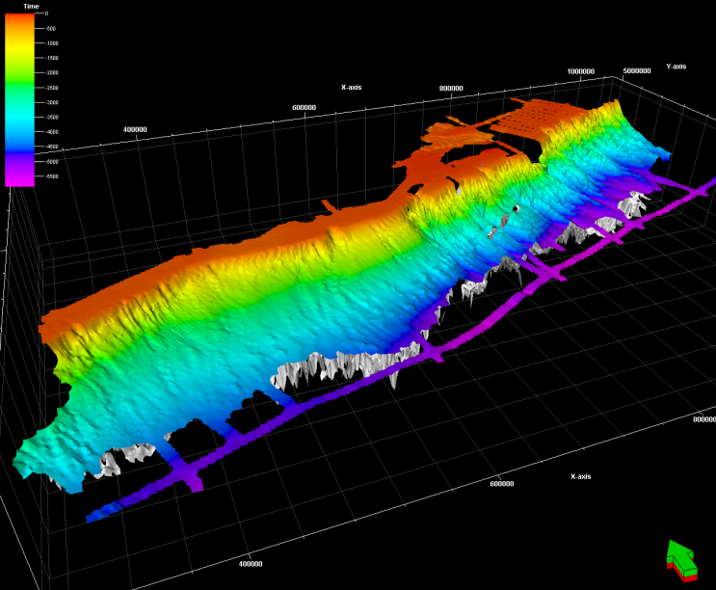

Nova Scotia Play Fairway Analysis
Gross Depositional Environments and Hydrocarbon Prospectivity
Hamish Wilson, Matt Luheshi, David Roberts, Bernard Colletta

Slide 2
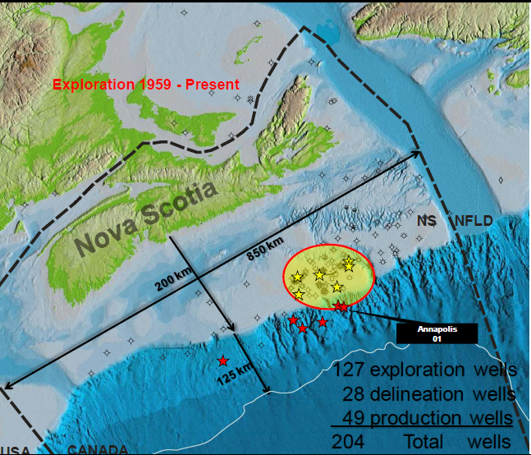
Notes:
204 wells have been drilled offshore Nova Scotia.
127 wells are classified as exploration wells and 28 as delineation.
49 production wells are centered around the 5 SOEP and 2 COPAN fields, highlighted by the yellow stars.
The 6 recent deepwater wells are highlighted in red.
2

Slide 3















Slide 4
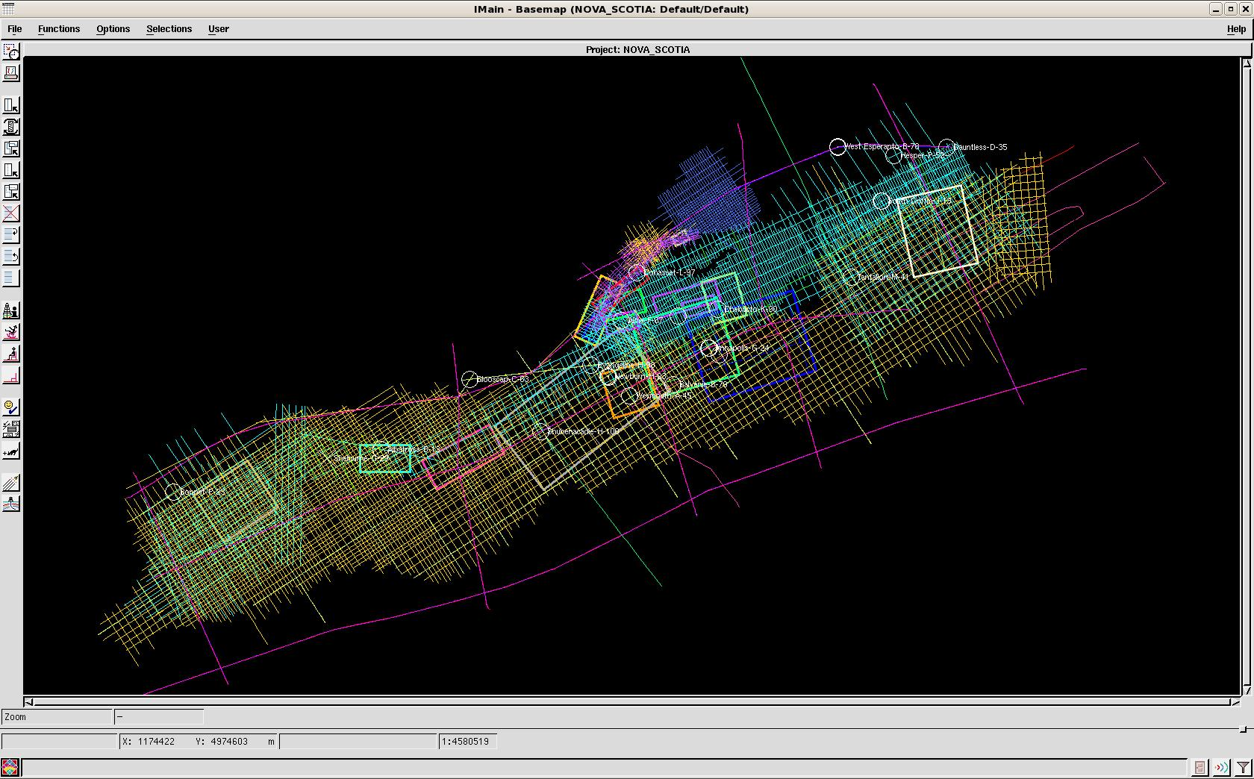
Database
~70000 km 2D
~30000 sq km 3D
20 key wells – Std Log suite
Biostratigraphy data
Synthetic seismograms
Variable spatial distribution
West Esperanto_B-78
Hesper_P-52
Dauntless_D-35
South_Griffin_J-13
Jurassic delta
Cretaceous delta
Cohasset_L-97
Slope area
Chebucto_K-90
Tantallon_M-41
Alma_F-67
Glenelg_J-48
Evangeline_H-98
Annapolis_G-24
Glooscap_C-63
Crimson_F-81
Newburn_H-23
Balvenie_B-79
Jurassic carbonate bank
Weymouth_A-45
Albatross-B13
Shubenacadie_H-100
Deep offshore area
Bonnet P-23
Shelburne_G-29
4/11/11
4

Slide 5
Outline
Demonstrated that there are two source rock types on the margin, extending prospectivity outside the Sable Delta region
Shown that there is a way to de-risk reservoir/seal both on the shelf but also in the deeper water.
Developed a rigorous petroleum systems model to predict charge/migration
Un-risked YTF resources of 121 TCF and 8bn bbls in three regions
  Deep water oil play in the South West and Gas to the North East
  Remaining gas potential in the Sable delta itself in dip closed features
  Gas and Oil in Sable rim and in the underexplored region to the North East of Sable

Slide 6
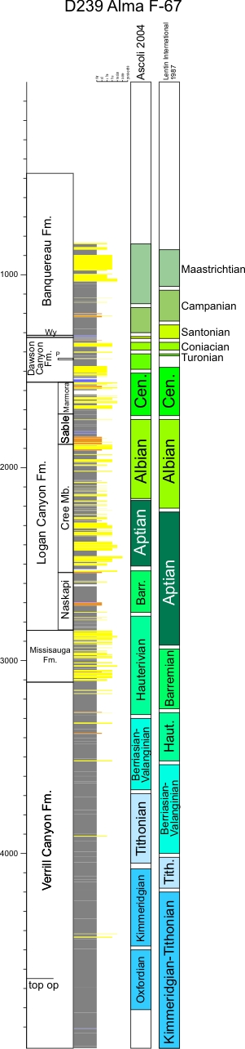
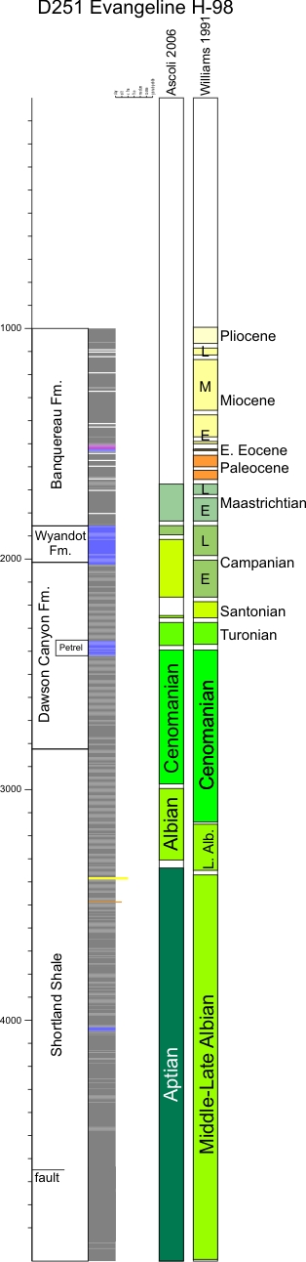
Andrew MacRae (SMU)
Stratigraphic Framework – Scotian Margin, offshore eastern Canada
Is Naskapi Member in Alma F-67
Barremian or Aptian?
(~350m difference in Barr/Aptian boundary)
Is the bottom 1500m (!) of Evangeline
Aptian or Mid-Late Albian?

Slide 7
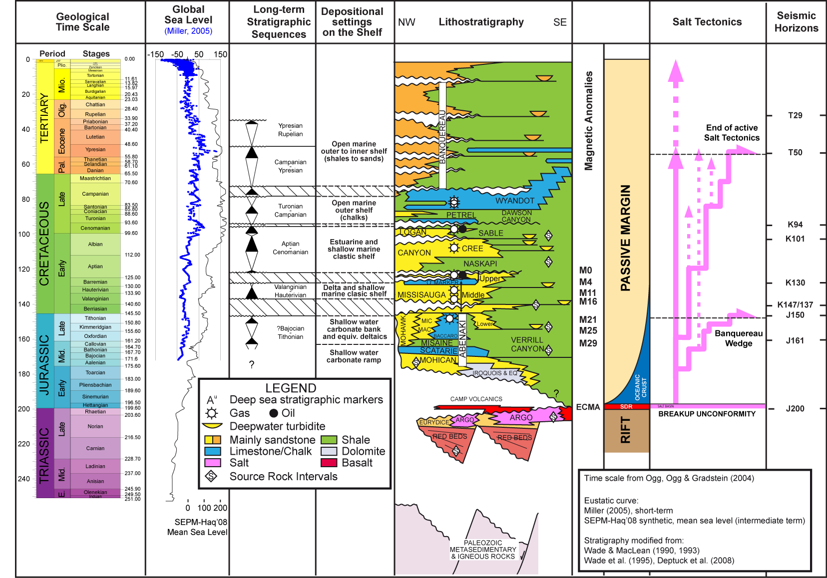
Reworking – revised age calls
Integration – multiple disciplines, seismic, wireline, lithostraigraphy
Consistent regional framework

Slide 8
Hydrocarbon occurrences and molecular analysis

Slide 9
Hydrocarbon occurrences
FIELDS
SHOWS
PISTONS
DHI

Slide 10
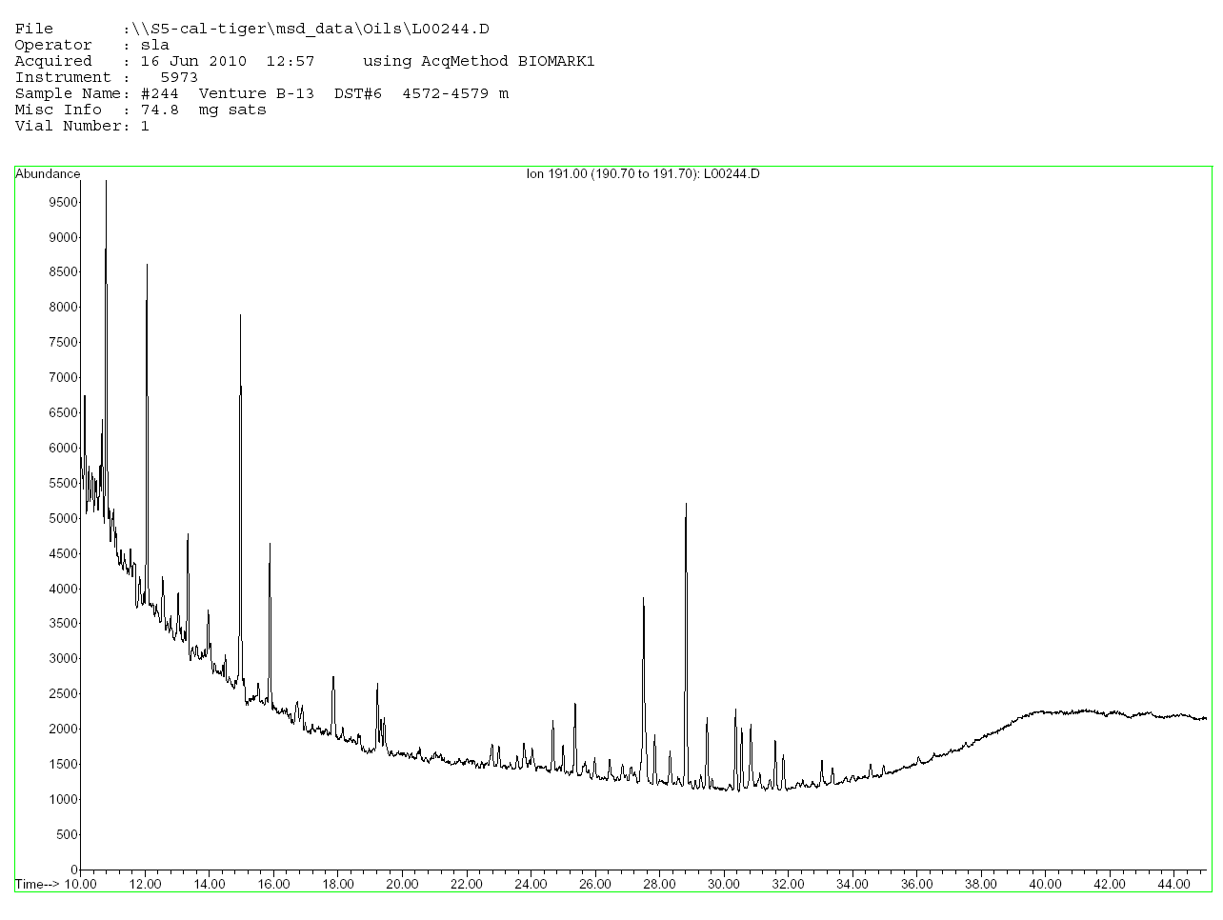
Venture B-13
VENTURE B-13
DST#6 4572.00 – 4579.00 m
Below top OP
Basal Missisauga
GSC group 3b
gammacerane

Slide 11
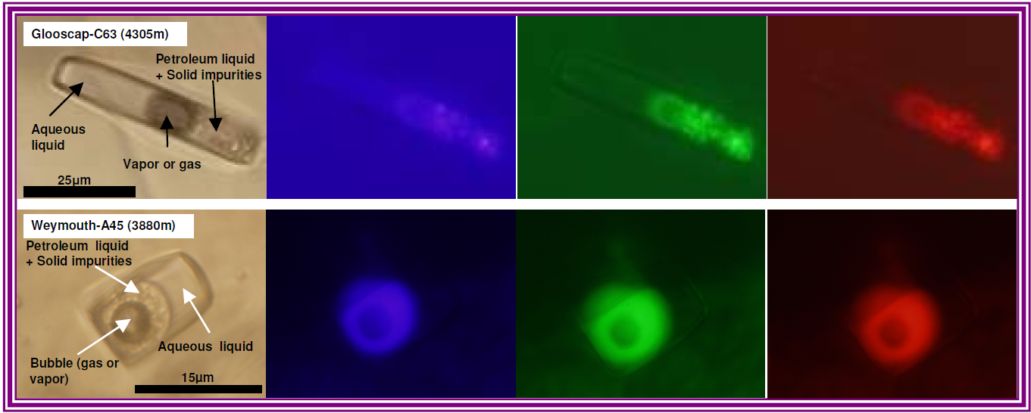
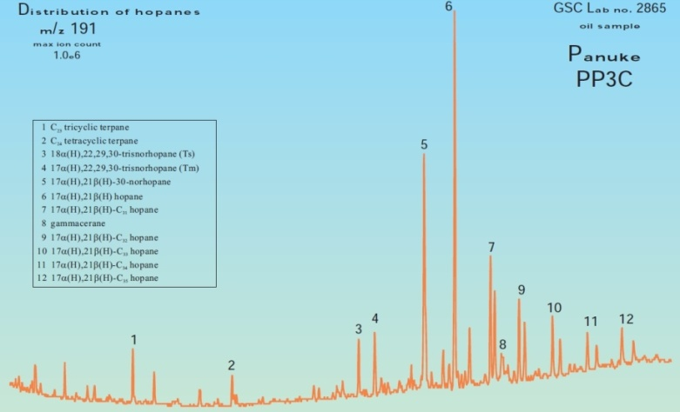
Hydrocarbon Fluid Inclusions from Glooscap and Weymouth
No oleanane
Glooscap
Glooscap
Gammacerane
Weymouth
Top salt
Gammacerane
Oleanane
Weymouth
Middle salt
C34 C35
Gammacerane
environment
Weymouth
Bottom mix
C34 C35
Ratio C35 to C34 homohopanes ~ 1 is indicative of a source rock deposited in a carbonate environment
Oleanane in deep Panucke suggests either contamination (oil-based mud) or leaching Upper Cretaceous along the migration path
Weymouth
Bottom salt
Gammacerane

Slide 12
Isotope distribution

Slide 13
Isotope - Extracts

Slide 14
All isotopes including Morocco oils

Slide 15
Forensic Geochemistry
Proof that there are two source rock groups
  One largely marine
  The other mixed marine terrestrial
Evidence for a restricted hypersaline source rock
Similar characteristics from oils on the conjugate margin in Morocco

Slide 16
Geochemistry
4 source rocks; 2 independent systems
Deltaic
  Upper Jurassic/Tithonian
  Lower Cretaceous/Hauterivian-Aptian
  Albian
Regional Early Jurassic restricted marine to marine

Slide 17
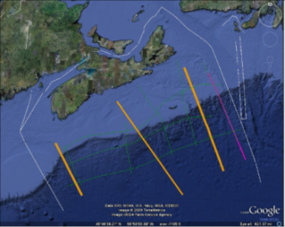
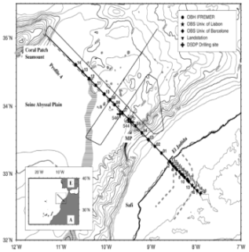
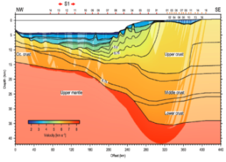
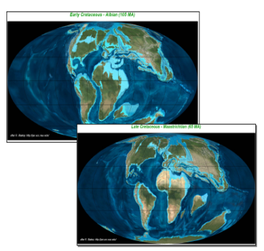
Tectonics programme
New Refraction Line
SISMAR reprocessing
Plate reconstruction
Magnetic reprocessing
Integrated interpretation
Structural modelling

Slide 18
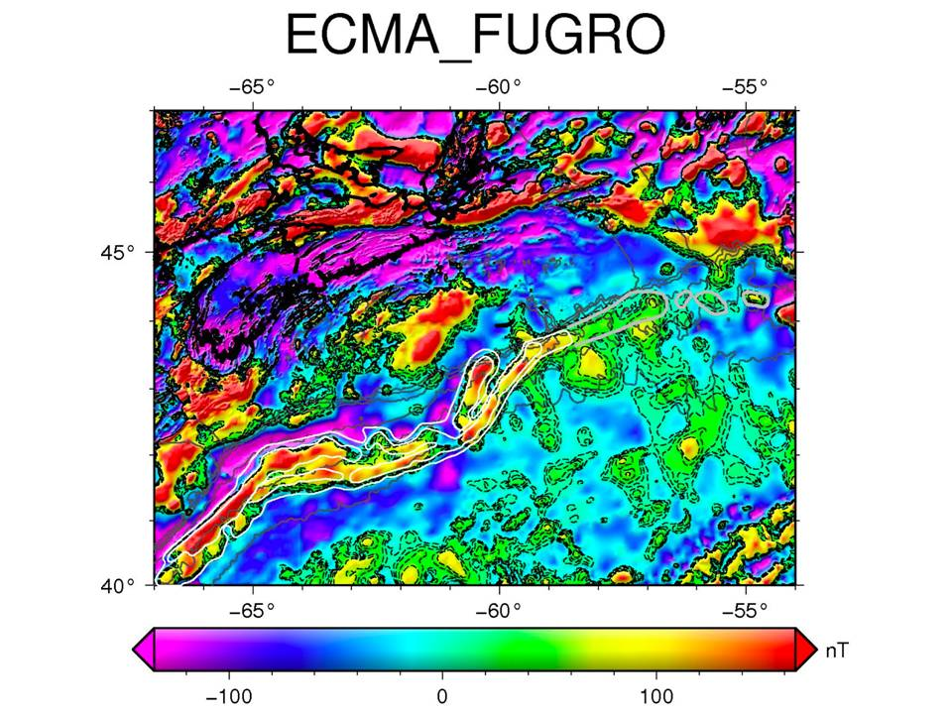

Slide 19
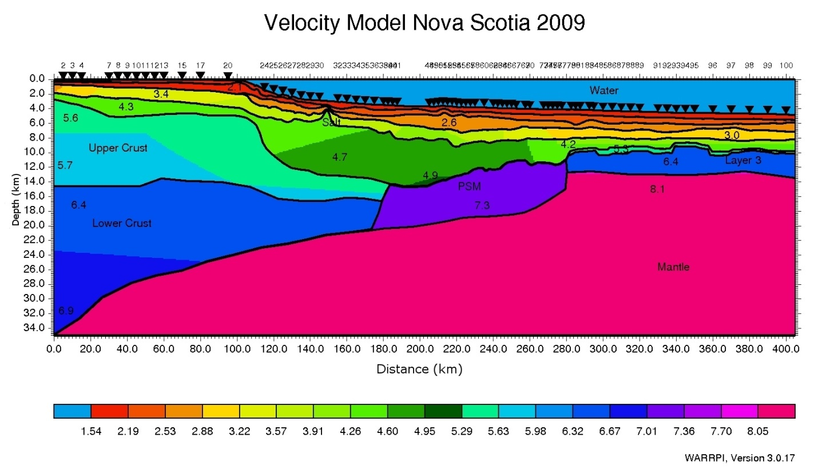
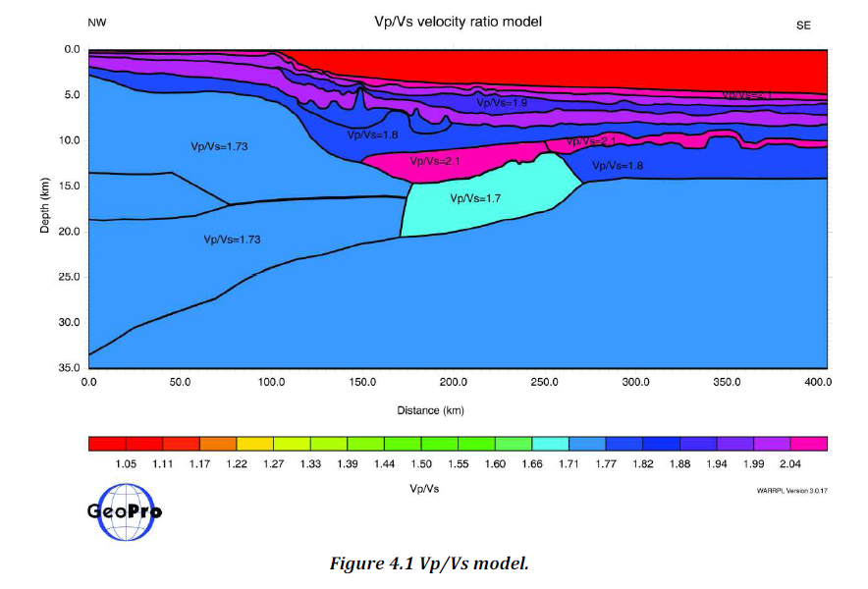
GEOPRO – Vp & Vp/Vs models
ECMA

Slide 20
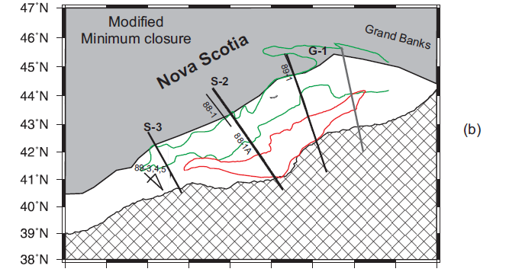
SDR observations (approx locations) – Nova Scotia & Morocco
GXT1100 &
89 series
SISMAR09
Roeser 2002
3D Essaouira
GXT1400
Reconstruction after Fig. 3.6 (b) Louden et. al. 2010; SDR identification PFA project

Slide 21
KEY CONCLUSIONS
Nova Scotia and Morocco are conjugate volcanic passive margins
Salt basins are wholly confined to continental crust stretched in the Late(?) Triassic
Subaerial spreading initiated by CAMP event in the Earliest Jurassic
Initial post rift water depths therefore probably less than 200m may have favoured anoxic conditions - ? a new petroleum system
Avalon (Late J-EK) deltas record response to the Avalon uplift due to Newfoundland –Iberia rifting

Slide 22
Basin Architecture

Slide 23
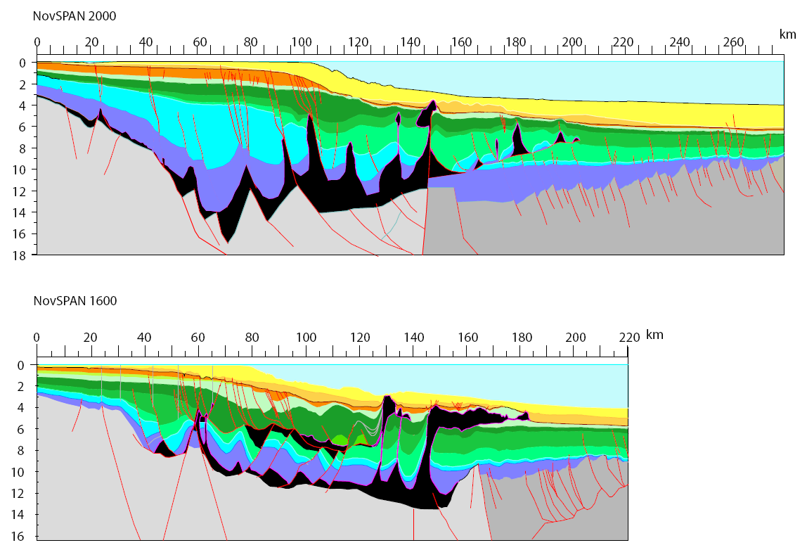
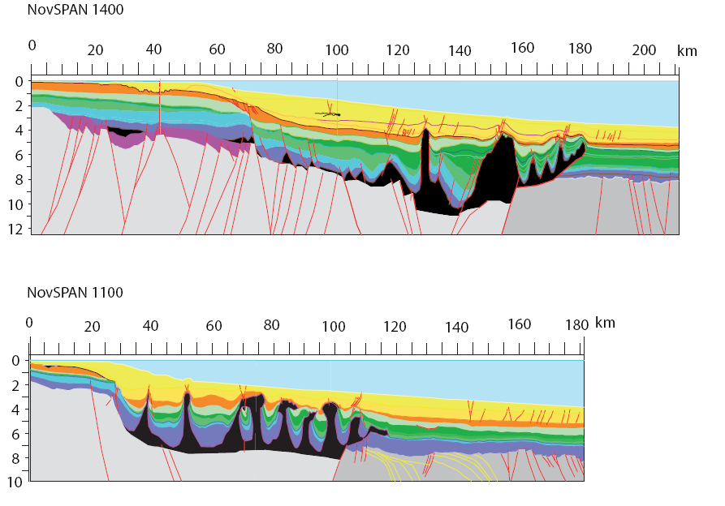

Slide 24
Sequence Stratigraphy

Slide 25
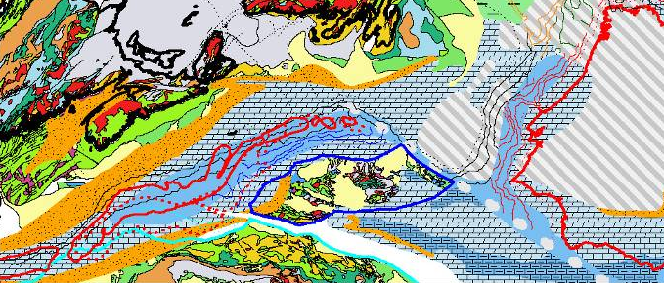
190 Ma

Slide 26
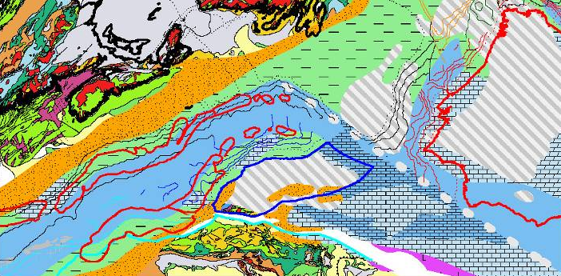
170 Ma

Slide 27
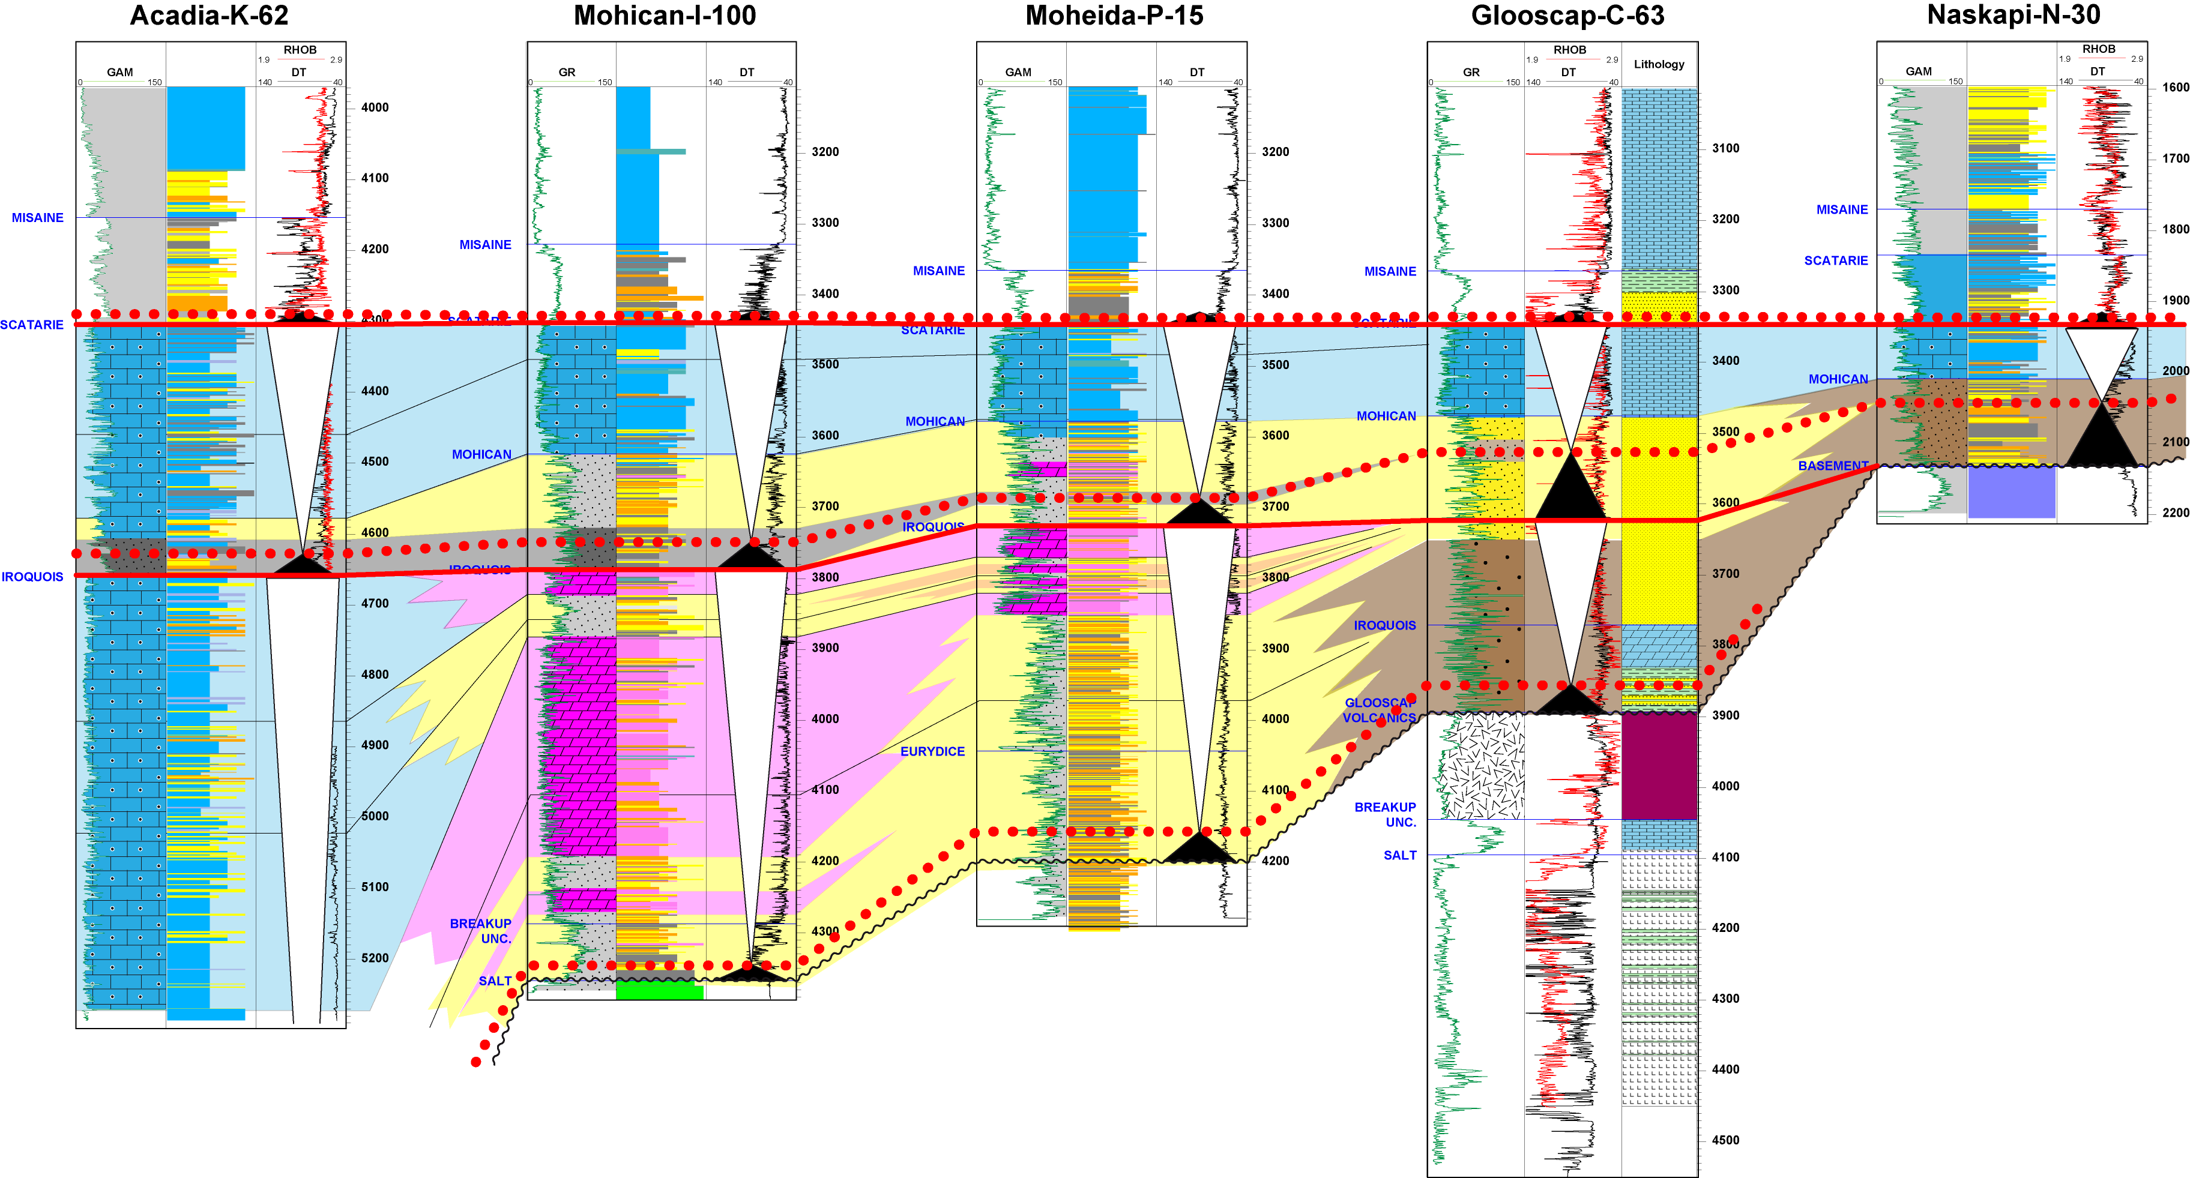
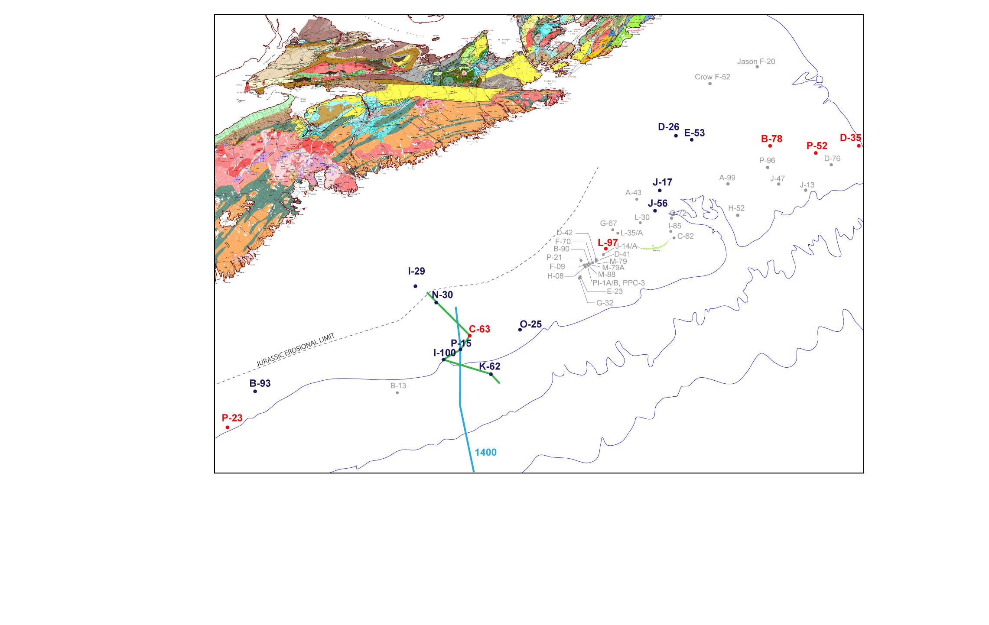
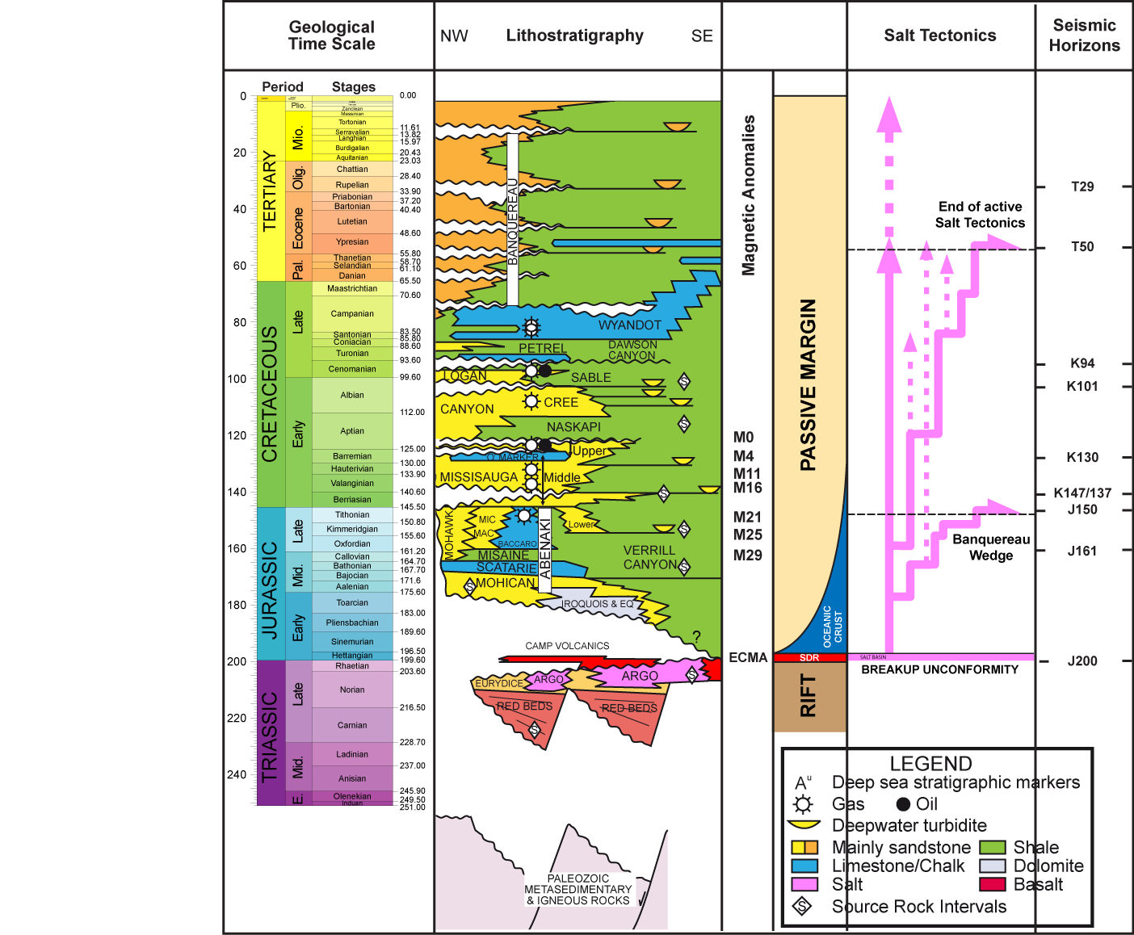
Stratigraphy of the Middle Jurassic
South
North
Depositional architecture for each sequence
Prograding clastics, ending up with shallow marine carbonates
Expansion of shallow marine carbonate through time (1st order transgression)

Slide 28

T200  J163 isopach map
Eq. Iroquois / Mohican / Scatarie Fm

Slide 29
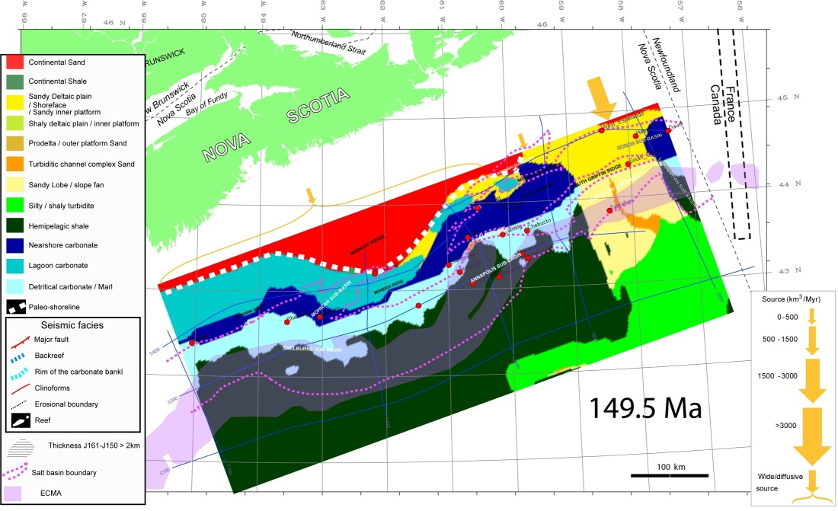
Jurassic modeling results : GDE maps dress-up for key stratigraphic intervals
LATE JURASSIC FORMATION
MICMAC - BACCARO - LOWER MISSISAUGA

Slide 30
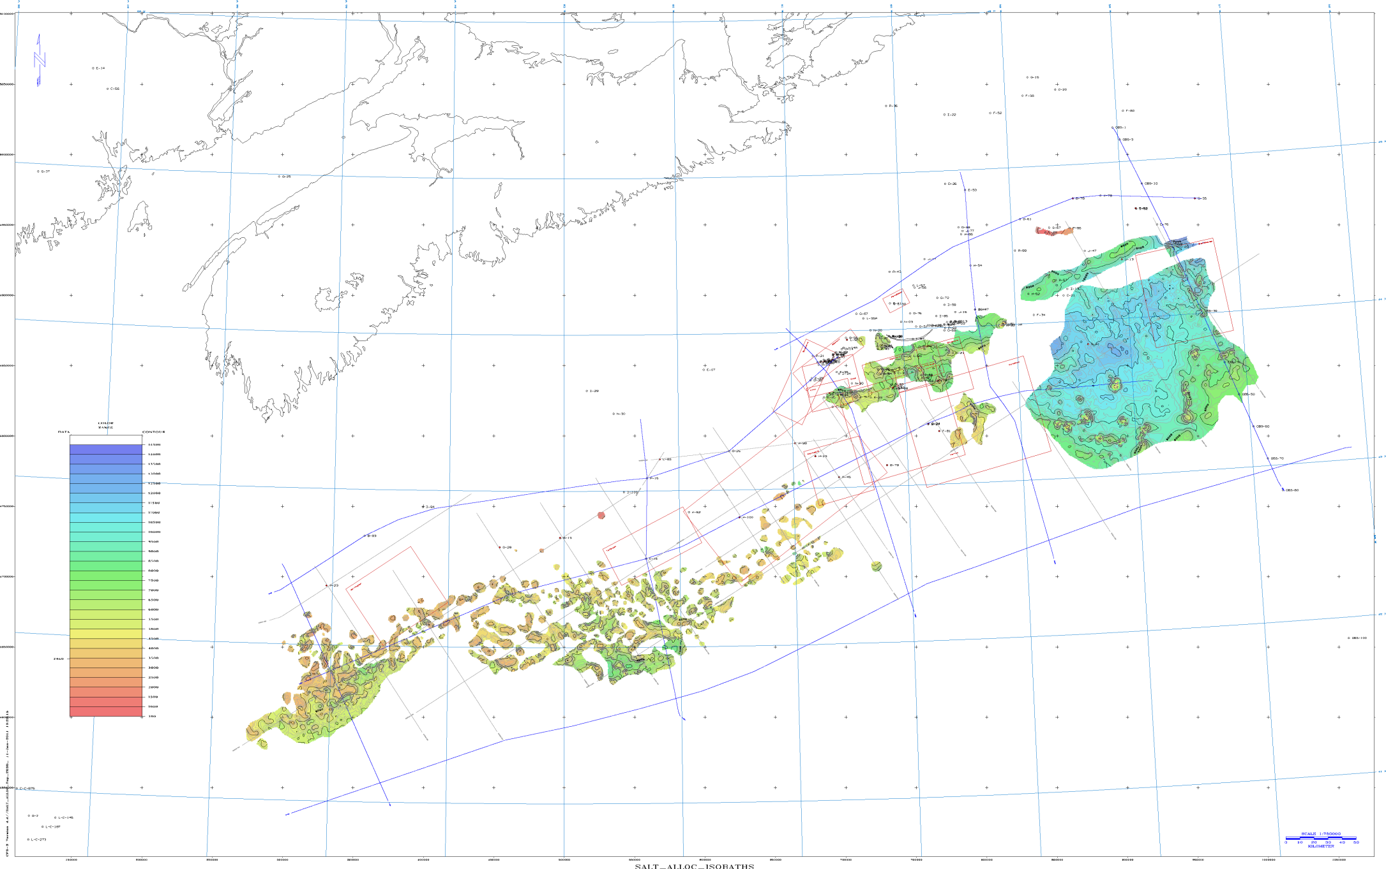
Allochthonous salt movement related to Jurassic delta loading
Laurentian
sub-basin
Banquereau
detachment wedge
14500 m
Autochthonous salt province
0 m
50 km

Slide 31
J150  K137 isopach map
Eq. Lower Missisauga Fm.

Slide 32
Middle Missisauga seismic facies and geometries
K137  K130 thickness map
J150  K137 isopach map

Slide 33
K130  K101 isopach map
Eq. Upper Missisauga + Logan Canyon Fm.

Slide 34
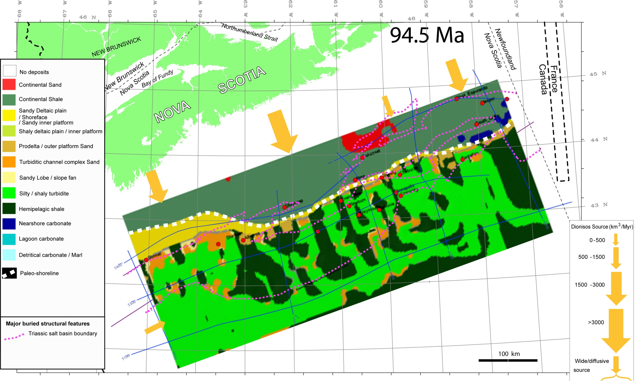
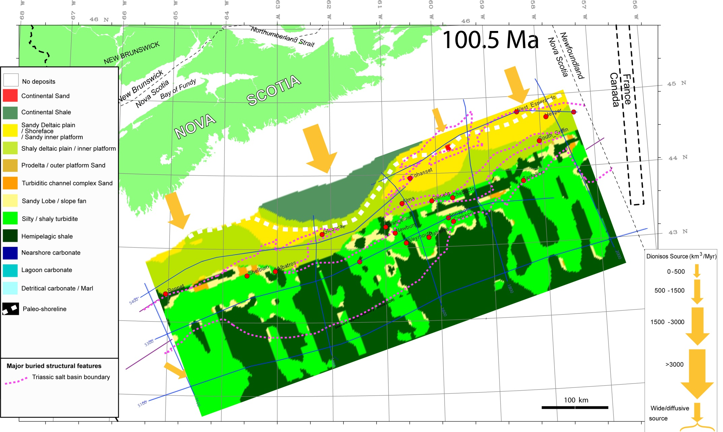
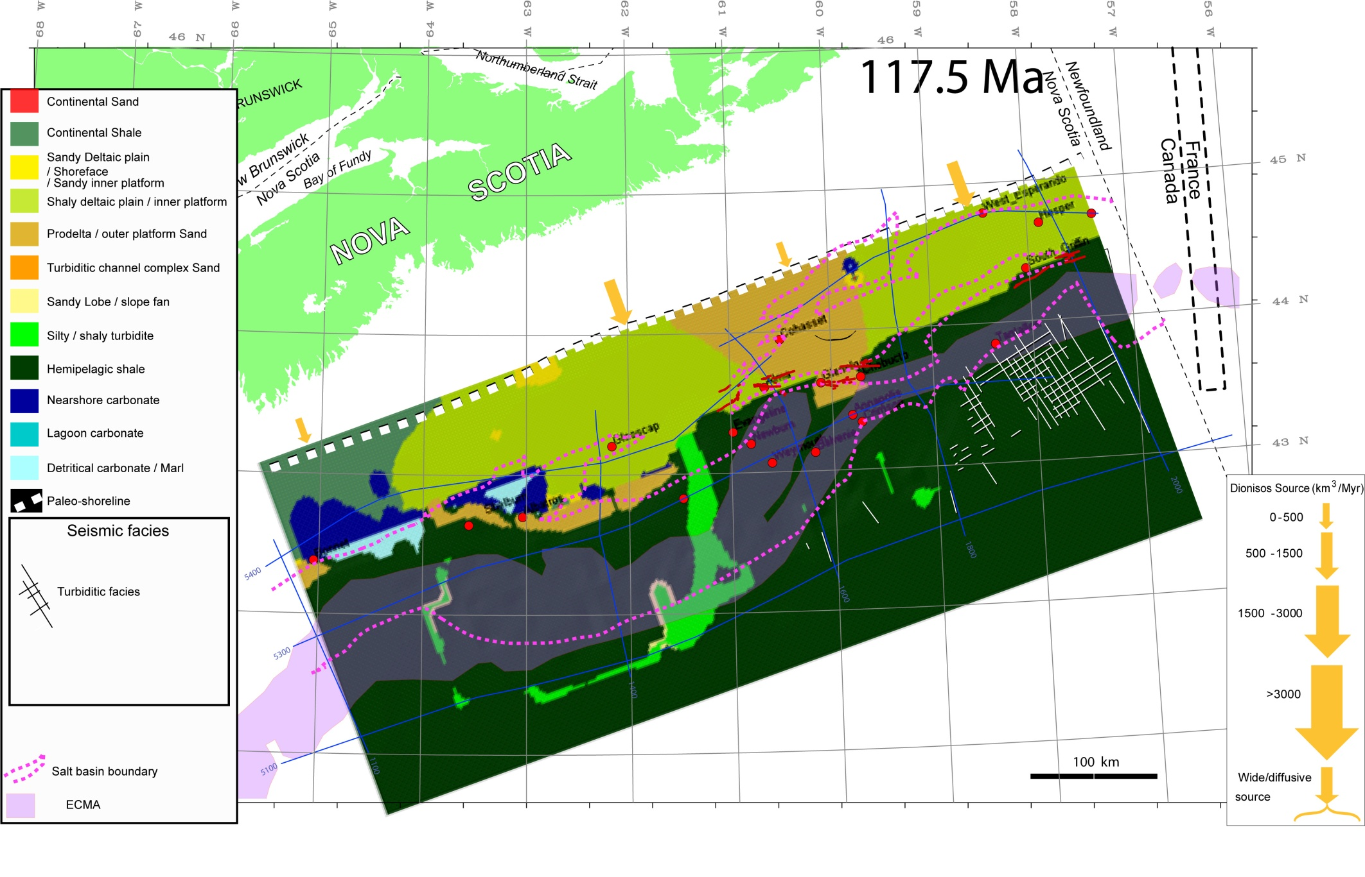
Cretaceous modeling results : GDE maps dress-up for key stratigraphic intervals
TOP CENOMANIAN
CENOMANIAN DEPOSITS
APTIAN TRANSGRESSION

Slide 35
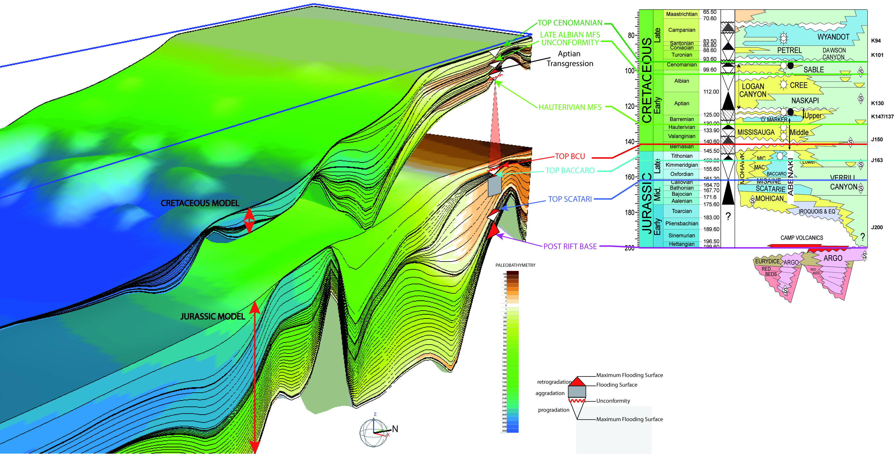
DIONISOS® Calibration: 2 models with « qualitative »
and « quantitative » calibration
Depositional profile with key sequences ….
…that fit the stratigraphic conceptual model

Slide 36

Jurassic and Cretaceous systems
Late Albian
Lowstand system 
K94 – K101
Jurassic deltaic system 
J150 – J200
Jurassic carbonate
system 
J150 - J185
◆
Late Albian Growth fault systems 
West Esperanto_B-78
Hesper_P-52
Dauntless_D-35
◆
◆
South_Griffin_J-13
◆

Cohasset_L-97
CC

CC
◆
⬥

OC
Chebucto_K-90

OC
❖
◆
Alma_F-67

Tantallon_M-41

Banquereau
Detachment Zone
Glenelg_J-48
Annapolis_G-24

Glooscap_C-63
Evangeline_H-98
Crimson_F-81
Basement high
CC
Balvenie_B-79
Newburn_H-23
OC
◆
◆
Weymouth_A-45
Albatross-B13
Salt Canopies
Berriasian /
Valanginian
“lowstand” delta 
K137-K147
◆
Shubenacadie_H-100
Bonnet P-23
Shelburne_G-29
Autochthonous salt
CC
OC
Early Cretaceous
Delta 
K94 – K137
CC
CC
CC
OC
OC
OC
CC
50 km
CC
OC
OC
Salt diapirism
4/11/11
36

Slide 37
Petroleum Systems

Slide 38
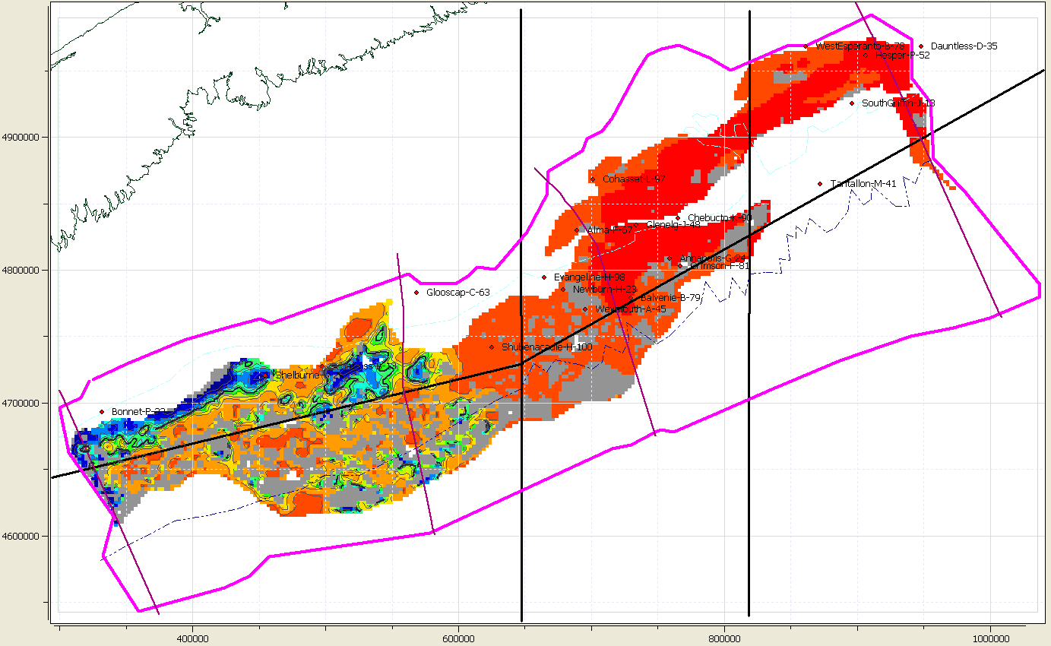

Source Rocks Modeling – Transformation Ratio
PLIENBACHIAN SR
APTIAN SR
VALANGINIAN SR
TITHONIAN SR
CALLOVIAN SR
PLIENBACHIAN SR
%
TRANSFORMATION RATIO

Slide 39
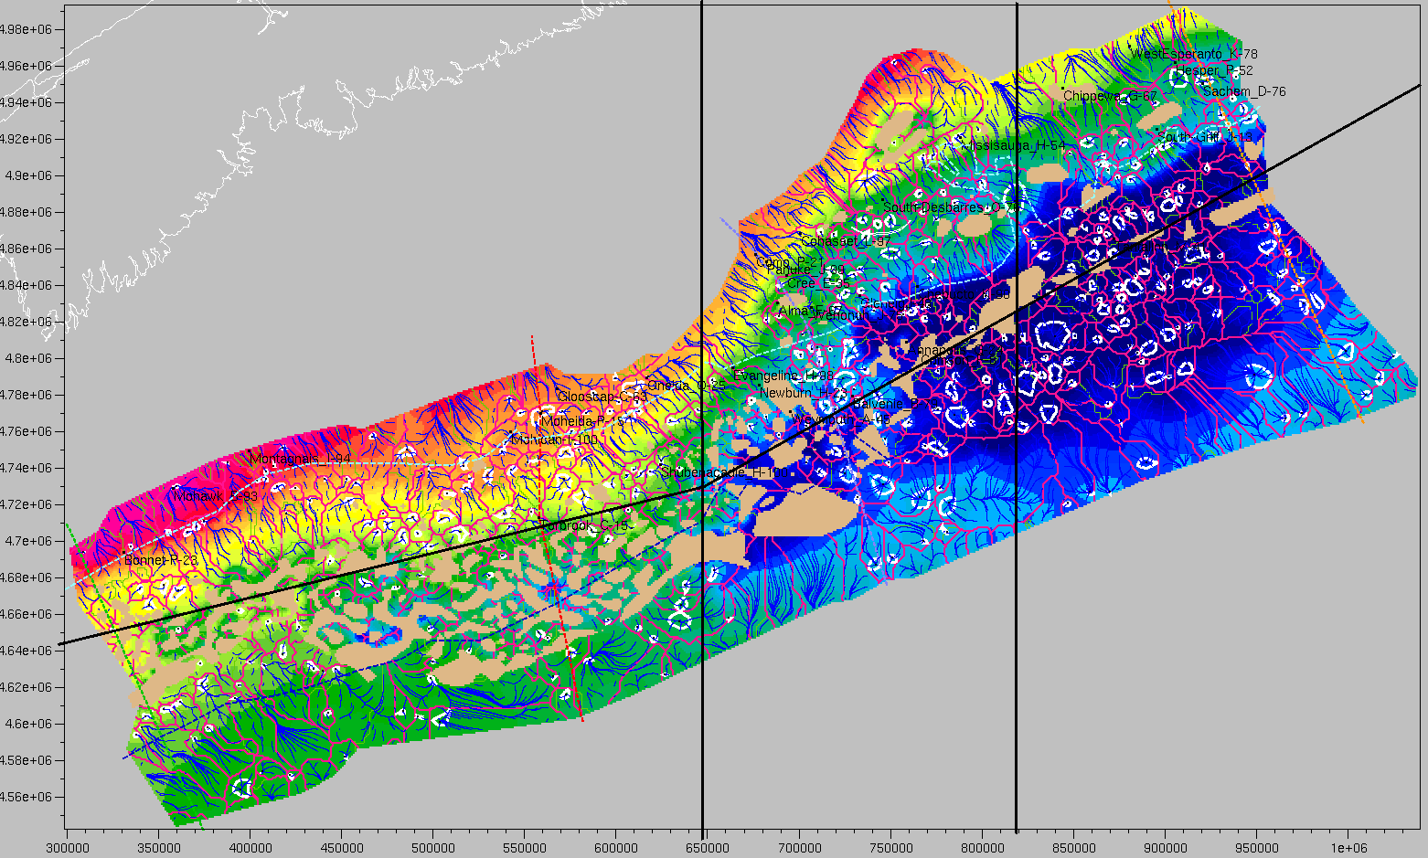
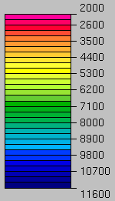
Migration and Accumulation Modeling – Drainage Areas Overview
Early-Middle-Jurassic (J200-J163)
PLAY
Aptian-Albian-Cenomanian (K112-K94)
Hauterivian-Barremian (K130-K123)
Berriasian-Valanginian-Hauterivian (J150-K130)
Oxfordian-Tithonian (J63-J150)
Early-Middle-Jurassic (J200-J163)
Depth in m
Pink lines = Main drainage divide
Blue lines = Slope lines / Flow path
White contour = Closure area
Background = horizon J163 depth

Slide 40
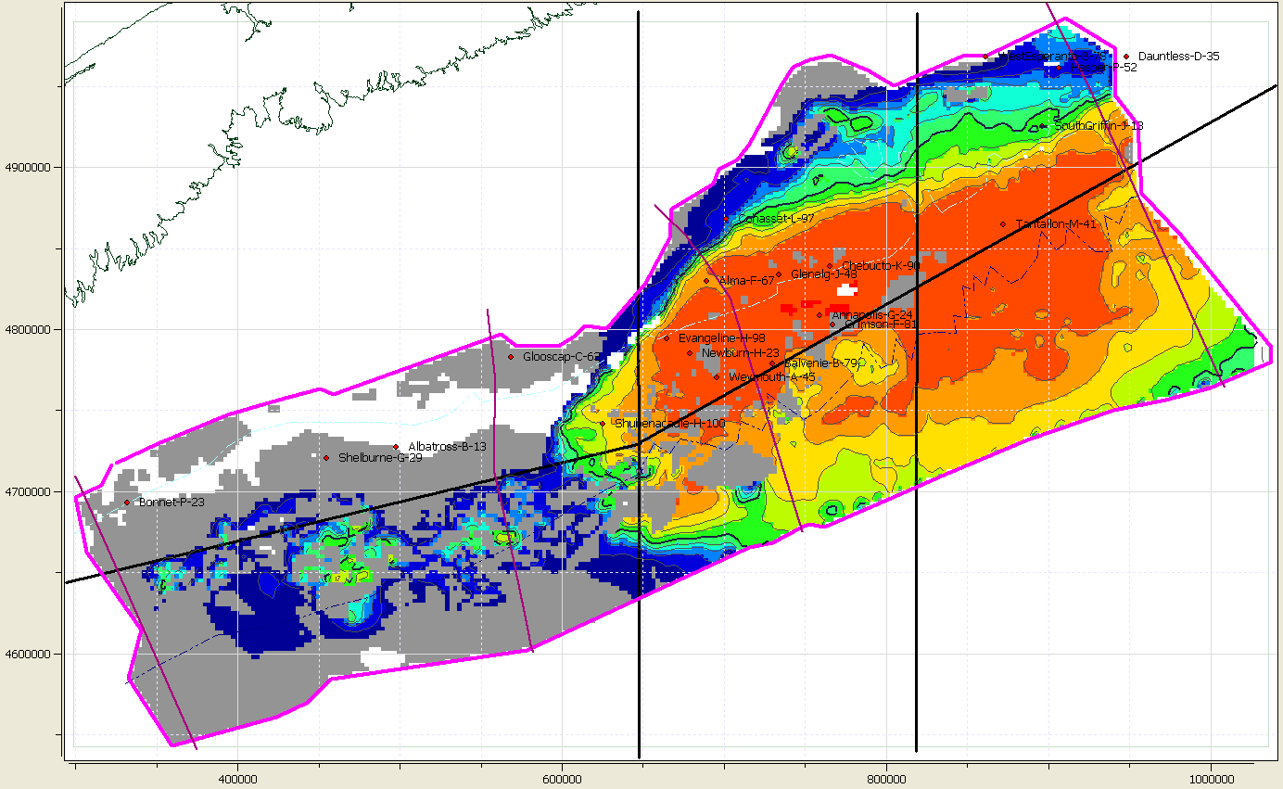
Source Rocks Modeling – Transformation Ratio
TITHONIAN SR
APTIAN SR
VALANGINIAN SR
TITHONIAN SR
CALLOVIAN SR
PLIENBACHIAN SR
%
TRANSFORMATION RATIO

Slide 41
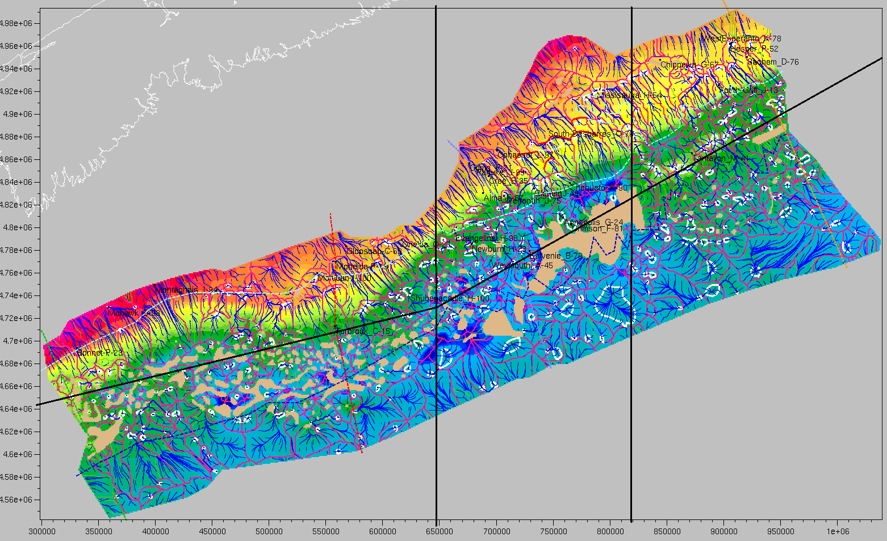
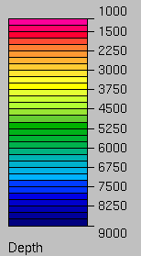
Migration and Accumulation Modeling – Drainage Areas Overview
Berriasian-Valanginian-Hauterivian (J150-K130)
PLAY
Aptian-Albian-Cenomanian (K112-K94)
Hauterivian-Barremian (K130-K123)
Berriasian-Valanginian-Hauterivian (J150-K130)
Oxfordian-Tithonian (J63-J150)
Early-Middle-Jurassic (J200-J163)
Depth in m
Pink lines = Main drainage divide
Blue lines = Slope lines / Flow path
White contour = Closure area
Background = horizon K130 depth

Slide 42
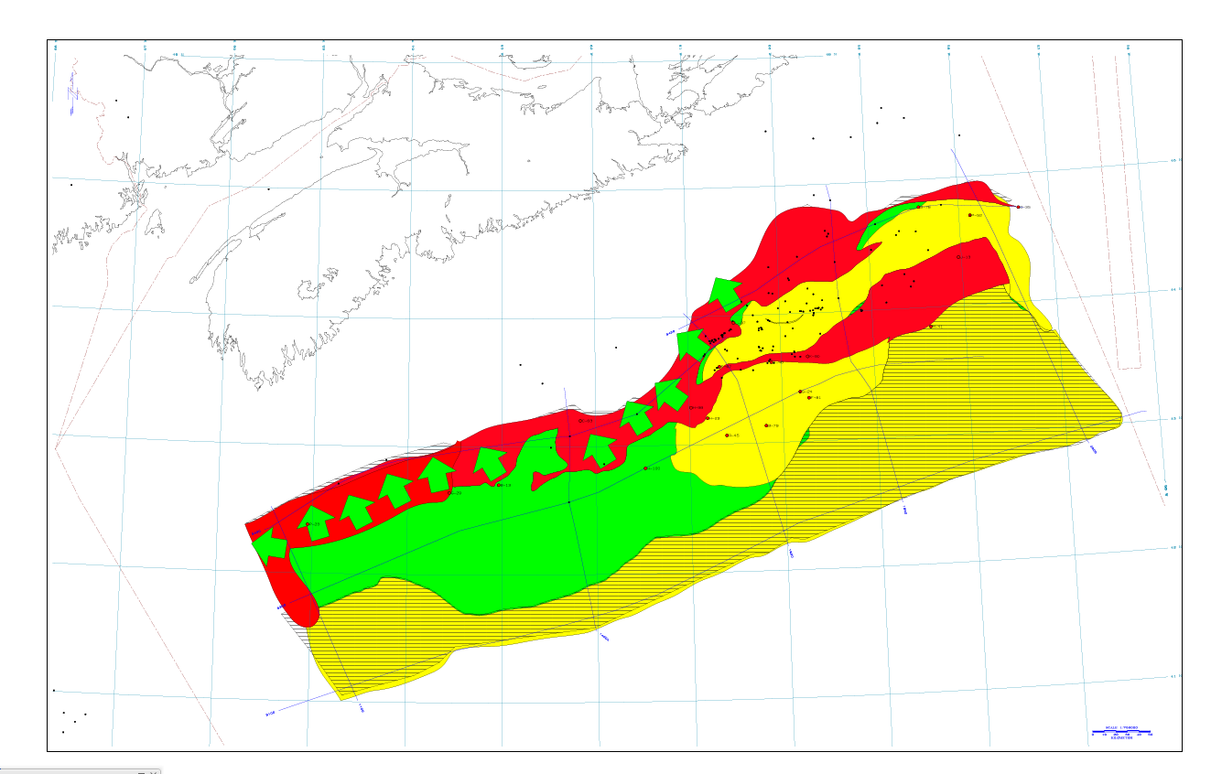
Pleinsbachian SR
Transformation ratio * Presence + Lateral migration potential

Slide 43
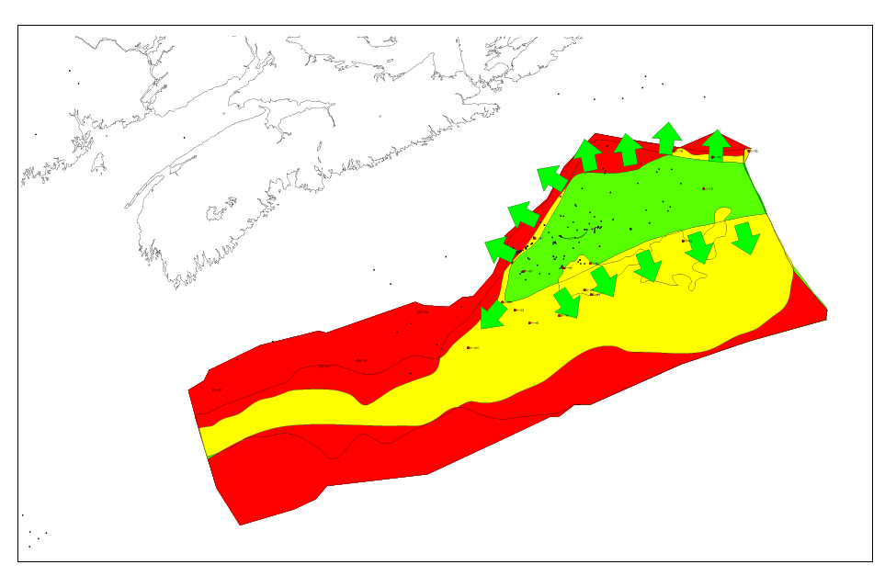
Tithonian SR
Transformation ratio * Presence + Lateral migration potential

Slide 44
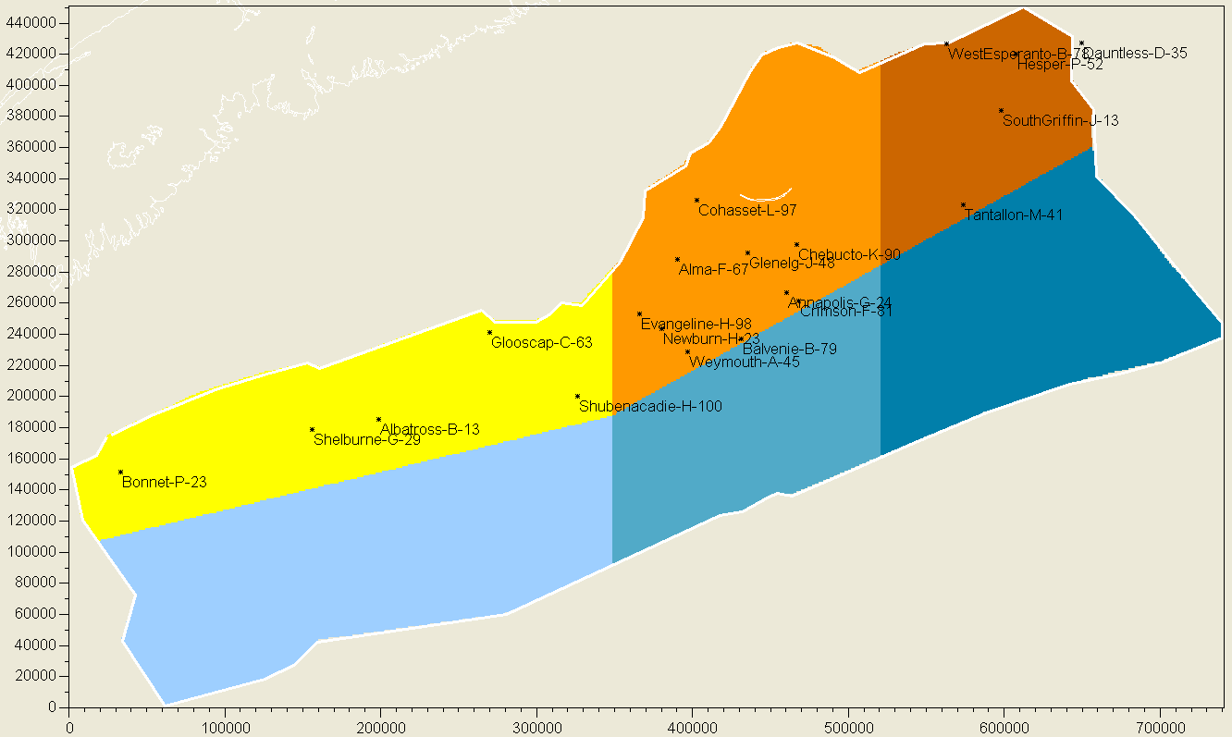
Introduction to 3D Basin Modeling – Study Area and Subzones Definition
Subzones defined on the basis of geological concept, and on exploration concerns.
There is no wells drilled in Basin Zones (in blue). The limit with Platform Zones (in yellow-brown) is close to the isobath 2000 m.
3
5
P a r t l y e x p l o r e d
6
1
4
U n e x p l o r e d
2
Most of the discoveries are in the Zone 3

Slide 45
CONCLUSION – ZONE RANKING – GAS VOLUME IN PLACE

Slide 46
CONCLUSION – ZONE RANKING – OIL VOLUME IN PLACE

Slide 47
CONCLUSION – Total HC Volume in the Basin
All closed structure (4 ways traps) considered, even subtle ones (in term of closure height, closure area, reservoir thickness).
Model rather optimistic in term of source rocks and plays (5 SRs and 5 potential reservoirs layers).
→ "Real reservoir" can be scattered in the play interval, non economic and/or non significant (in production tests).
3
5
6
1
4
2

Slide 48
Conclusions
YTF Unrisked of 120 TCF Gas, and 8bn bbls oil in world scale structures
Two main source rocks
  Pleinsbachian
  Tithonian
Three Play Systems
  Jurassic carbonates (reef and oolites)
  Middle and Upper Jurassic Clastics
  Lower Cretaceous delta and turbidites
Rigorous stratigraphic framework to develop prospects

